Slide 1
Estimasi Permintaan
Toni Prasetiyo, S.E., M.Ak.

Slide 2
Pokok Bahasan : Estimasi Permintaan
Masalah Identifikasi
Pendekatan Penelitian Pemasaran untuk Estimasi Permintaan
Analisis Regresi
  Regresi Sederhana
  Regresi Berganda
Masalah dalam Analisis Regresi
Mengestimasi Permintaan Regresi

Slide 3
Pokok Bahasan: Ramalan Permintaan
Peramalan Kualitatif :
  Survei & Jajak Pendapat
Peramalan Kuantitatif :
  Analisis Deret Waktu
  Teknik Penghalusan
  Metode Barometrik
  Model Ekonometrik
  Model Input-Output
Ringkasan, Pertanyaan Diskusi, Soal-Soal dan Alamat Situs Internet

Slide 4
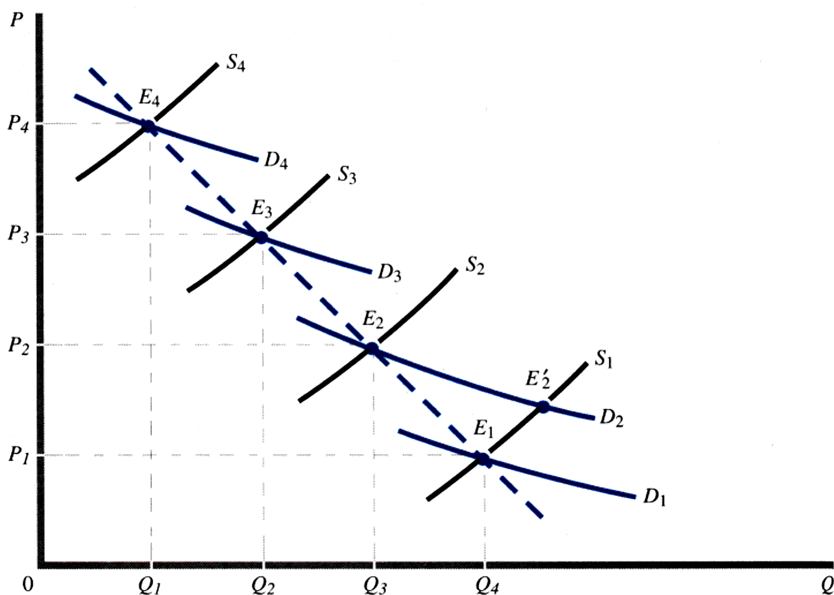
Masalah Identifikasi
Observasi Harga-Quantitas TIDAK SECARA LANGSUNG menghasilkan kurva Permintaan dari suatu komoditas

Slide 5
Estimasi Permintaan: Pendekatan Riset Pemasaran
Survei Konsumen : mensurvei konsumen bgm reaksi terhadap jumlah yg diminta jika ada perubahan harga, pendapatan, dll menggunakan kuisioner
Penelitian Observasi : pengumpulan informasi ttg preferensi konsumen dengan mengamati bagaimana mereka membeli dan menggunakan produk
Klinik Konsumen : eksperimen lab dimana partisipan diberi sejumlah uang tertentu dan diminta membelanjakannya dalam suatu toko simulasi dan mengamati bagaimana reaksi mereka jika terjadi perubahan harga, pendapatan, selera, dll
Eksperimen Pasar : mirip klinik konsumen, tetapi dilaksanakan di pasar yang sesungguhnya

Slide 6
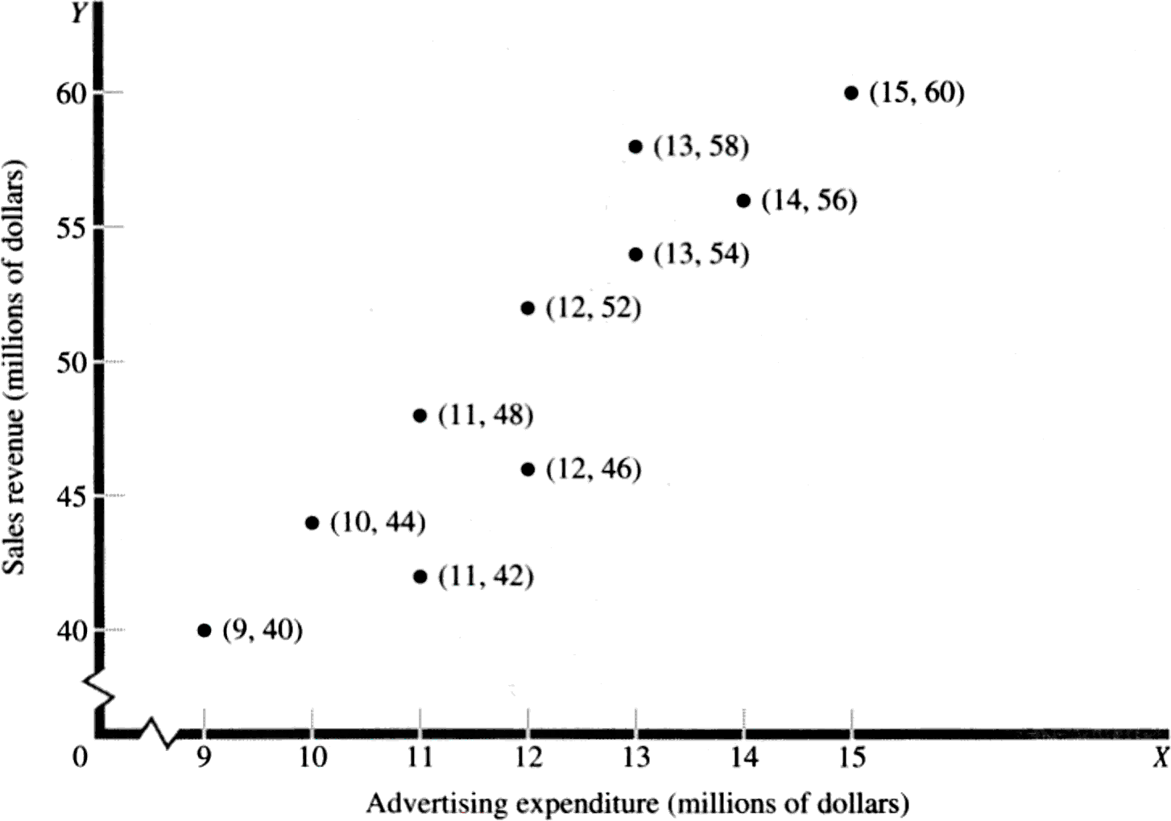
Analisis Regresi
Scatter Diagram
Year | X | Y
1 | 10 | 44
2 | 9 | 40
3 | 11 | 42
4 | 12 | 46
5 | 11 | 48
6 | 12 | 52
7 | 13 | 54
8 | 13 | 58
9 | 14 | 56
10 | 15 | 60
Persamaan Regresi : Y = a + bX

Slide 7
Analisis Regresi
Garis Regresi : Line of Best Fit.
Garis Regresi : meminimunkan jumlah dari simpangan kuadrat pada sumbu vertikal (e_{t}) dari setiap titik pada garis regresi tersebut.
Metode OLS (Ordinary Least Squares): metode jumlah kuadrat terkecil.

Slide 8
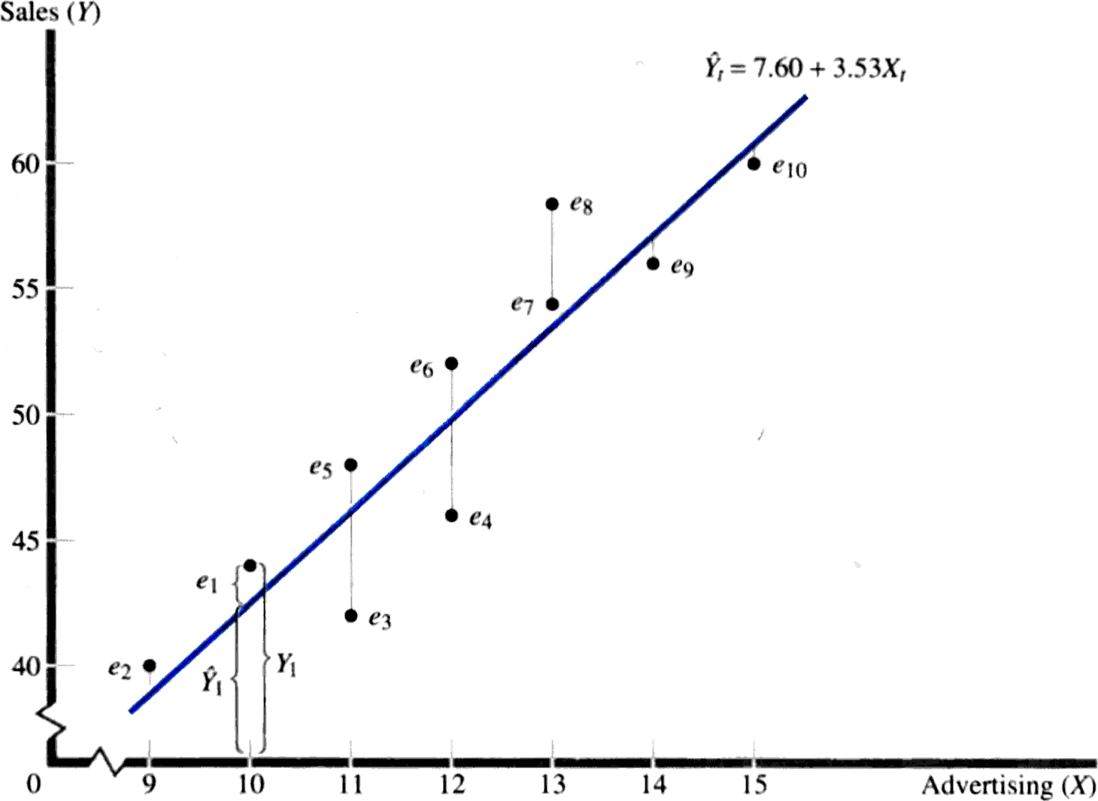
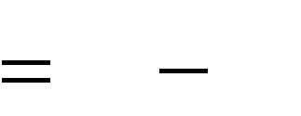
Menggambarkan Garis Regresi
_{Y}ˆ
e_{t} Y_{t}
t

Slide 9
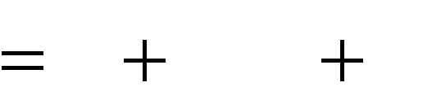

Y_{t} a bX_{t} e_{t}
Analisis Regresi Sederhana
Metode : OLS
Model:
_{Y}ˆ
aˆ
e_{t} Y_{t}
b^{ˆ}X
t
t
_{Y}ˆ
t

Slide 10

Metode OLS
Tujuan: menentukan kemiringan (slope) dan intercept yang meminimumkan jumlah simpangan kuadrat (sum of the squared errors).
n n
n
_{e}2
ˆ
ˆ
(Y Y
2
aˆ
2
) (Y
bX )
t
t t
t
t
t 1
t 1
t 1

Slide 11






Metode OLS
Prosedur Estimasi :
n
( X_{t} X )(Y_{t} Y )
_{b}ˆ
t 1
n
( X X )²
t
t 1
aˆ
Y b^{ˆ}X

Slide 12

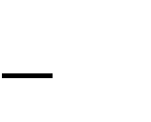





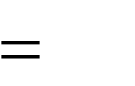







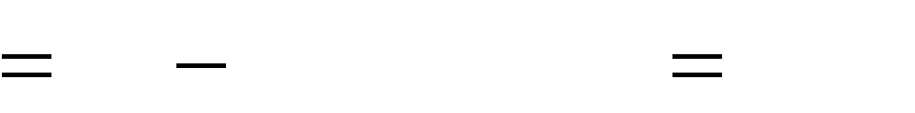







Metode OLS
Contoh Estimasi
Time | X _{t} | Y_{t} | X_{t} X | Y_{t} Y | ( X_{t} X )(Y_{t} Y ) | ( X X )² t
1 | 10 | 44 | -2 | -6 | 12 | 4
2 | 9 | 40 | -3 | -10 | 30 | 9
3 | 11 | 42 | -1 | -8 | 8 | 1
4 | 12 | 46 | 0 | -4 | 0 | 0
5 | 11 | 48 | -1 | -2 | 2 | 1
6 | 12 | 52 | 0 | 2 | 0 | 0
7 | 13 | 54 | 1 | 4 | 4 | 1
8 | 13 | 58 | 1 | 8 | 8 | 1
9 | 14 | 56 | 2 | 6 | 12 | 4
10 | 15 | 60 | 3 | 10 | 30 | 9
 | 120 | 500 |  |  | 106 | 30
n 10
n
X 120
n
Y 500
n
( X X )² 30
t 1
ˆ
106
30
t
t
t
b
3.533
t 1
t 1
n
X_{t} 120
n 10
n _{Yt}
t 1 n
500
10
n
( X X )(Y
Y ) 106
aˆ 50 (3.533)(12) 7.60
X
12
Y
50
t 1
t
t
t 1

Slide 13
Metode OLS
Contoh Estimasi
n
X_{t} 120
n 10
n 10
X
12
t 1
n
n
n
Y_{t} 500
n 10
X_{t} 120
Y_{t} 500
Y
50
t 1
t 1
t 1
n
_{b}ˆ
106
( X X )² 30
3.533
t
30
t 1
n
( X_{t} X )(Y_{t}
Y ) 106
aˆ
50 (3.533)(12)
7.60
t 1

Slide 14



Uji Signifikansi
Standard Error of the Slope Estimate
_{e}2
(Y Y^{ˆ})²
t
s
t
_{b}ˆ
(n k) (X X )² (n k) (X X )²
t
t

Slide 15






Uji Signifikansi
Contoh Perhitungan
Time | X _{t} | Y_{t} | _{Y}ˆ t | e_{t} Y_{t} Y^{ˆ} t | e² (Y Y^{ˆ} )² t t t | ( X X )² t
1 | 10 | 44 | 42.90 | 1.10 | 1.2100 | 4
2 | 9 | 40 | 39.37 | 0.63 | 0.3969 | 9
3 | 11 | 42 | 46.43 | -4.43 | 19.6249 | 1
4 | 12 | 46 | 49.96 | -3.96 | 15.6816 | 0
5 | 11 | 48 | 46.43 | 1.57 | 2.4649 | 1
6 | 12 | 52 | 49.96 | 2.04 | 4.1616 | 0
7 | 13 | 54 | 53.49 | 0.51 | 0.2601 | 1
8 | 13 | 58 | 53.49 | 4.51 | 20.3401 | 1
9 | 14 | 56 | 57.02 | -1.02 | 1.0404 | 4
10 | 15 | 60 | 60.55 | -0.55 | 0.3025 | 9
 |  |  |  |  | 65.4830 | 30
n
n
n
(Y Y^{ˆ})²
65.4830
_{e}2
ˆ
2
s_{ˆ}
b
t
0.52
t
(Y Y )
65.4830
( X X )² 30
(n k)
( X X )²
(10 2)(30)
t 1
t 1
t t
t 1
t
t

Slide 16
Uji Signifikansi
Contoh Perhitungan
n n
_{e}2
ˆ
(Y Y )
2
65.4830
t
t t
t 1
t 1
n
( X X )² 30
t
t 1
65.4830
(n k) ( X X )² (10 2)(30)
(Y Y^{ˆ})²
s
t
0.52
_{b}ˆ
t

Slide 17

Uji Signifikansi
Perhitungan : t-Statistic
_{b}ˆ
3.53
t
6.79
s_{ˆ} 0.52
b
Derajat Bebas = (n-k) = (10-2) = 8
Critical Value at 5% level =2.306

Slide 18

Uji Signifikansi
Decomposition of Sum of Squares
Total Variation = Explained Variation + Unexplained Variation
(Y Y )² (Y^{ˆ} Y )² (Y Y^{ˆ} )²
t t t

Slide 19
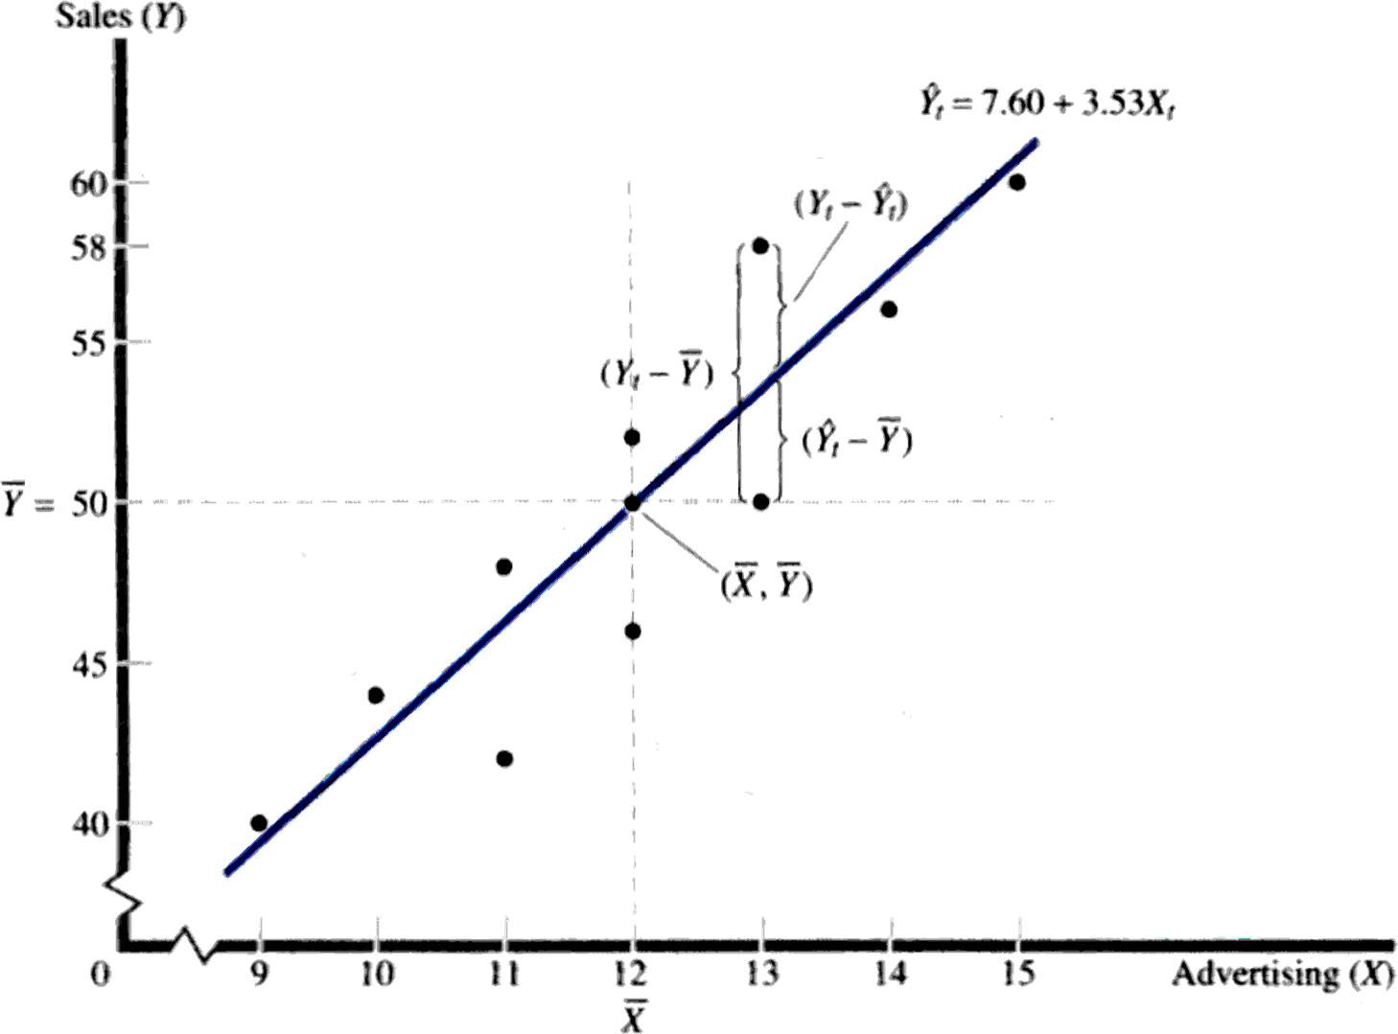
Uji Signifikansi
Decomposition of Sum of Squares

Slide 20





Uji Signifikansi
Koefisien Determinasi
_{R2} (Y^{ˆ} Y )²
Total Variation
Explained Variation
(Y Y )²
t
_{R}2
373.84
0.85
440.00

Slide 21

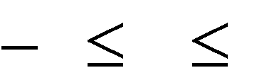

Uji Signifikansi
Koefisien Korelasi
r R² withthe signof b^{ˆ}
1 r 1
r 0.85 0.92

Slide 22


Analisis Regresi Berganda
Model:
Y a
b₁ X₁
b₂ X ₂
^{b}k ' ^{X}k '

Slide 23
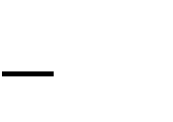


Analisis Regresi Berganda
Adjusted Coefficient of Determination
_{R2 )} (n 1)
(n k)
_{R}2
1 (1

Slide 24






Analisis Regresi Berganda
Analysis of Variance and F Statistic
Explained Variation /(k 1)
Unexplained Variation /(n k)
R² /(k 1)
(1 R² ) /(n k )
F
F

Slide 25
Masalah-Masalah dalam Analisis Regresi
Multicollinearity: Dua atau lebih variabel bebas mempunyai korelasi yang sangat kuat.
Heteroskedasticity: Variance of error term is not independent of the Y variable.
Autocorrelation: Consecutive error terms are correlated.

Slide 26





Durbin-Watson Statistic
Uji Autocorrelation
n
₎2
(e e
t t 1
d
t 2
n
_{e}2
t
t 1
If d=2, autocorrelation is absent.

Slide 27
Langkah-Langkah Estimasi Permintaan dengan Regresi
Spesifikasi Model dengan Cara Mengidentifikasi Variabel-Variabel, misalnya :
Q_{d} = f (P_{x}, I, P_{y}, A, T)
Pengumpulan Data
Spesifikasi Bentuk Persamaan Permintaan Linier : Q_{d} = A - a₁P_{x} + a₂ I + a₃ P_{y} + a₄ A + a₅ T Pangkat : Q_{d} = A(P_{x})^{b}(P_{y})^{c}
Estimasi Nilai-Nilai Parameter
Pengujian Hasil

Slide 28
Qualitative Forecasts
Survey Techniques
  Planned Plant and Equipment Spending
  Expected Sales and Inventory Changes
  Consumers’ Expenditure Plans
Opinion Polls
  Business Executives
  Sales Force
  Consumer Intentions

Slide 29
Time-Series Analysis
Secular Trend
  Long-Run Increase or Decrease in Data
Cyclical Fluctuations
  Long-Run Cycles of Expansion and Contraction
Seasonal Variation
  Regularly Occurring Fluctuations
Irregular or Random Influences

Slide 30
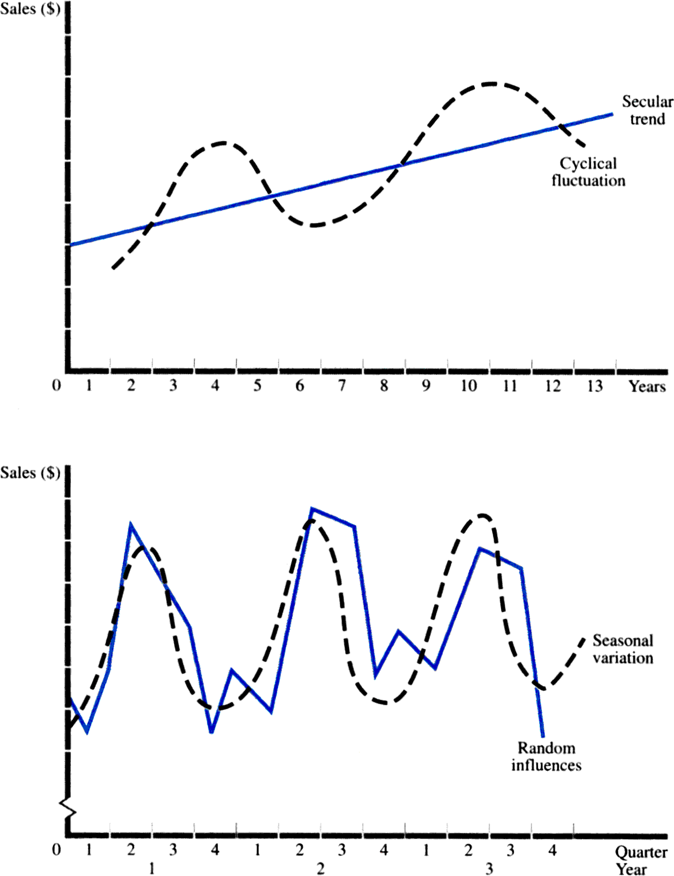

Slide 31
Trend Projection
Linear Trend:
S_{t} = S₀ + b t
b = Growth per time period
Constant Growth Rate:
S_{t} = S₀ (1 + g)^{t}
g = Growth rate
Estimation of Growth Rate :
lnS_{t} = lnS₀ + t ln(1 + g)

Slide 32

Seasonal Variation
Ratio to Trend Method
Actual Trend Forecast
Ratio =
Seasonal Adjustment
=
Average of Ratios for Each Seasonal Period
Adjusted Forecast
Trend Forecast
Seasonal Adjustment
=

Slide 33
Seasonal Variation
Ratio to Trend Method: Example Calculation for Quarter 1
Trend Forecast for 1996.1 = 11.90 + (0.394)(17) = 18.60
Seasonally Adjusted Forecast for 1996.1 = (18.60)(0.8869) = 16.50
Year | Trend Forecast | Actual | Ratio
1992.1 | 12.29 | 11.00 | 0.8950
1993.1 | 13.87 | 12.00 | 0.8652
1994.1 | 15.45 | 14.00 | 0.9061
1995.1 | 17.02 | 15.00 | 0.8813
Seasonal Adjustment = 0.8869

Slide 34




Moving Average Forecasts
Forecast is the average of data from w
periods prior to the forecast data point.
w
A_{t}
F
i
t
w
i 1

Slide 35



Exponential Smoothing Forecasts
Forecast is the weighted average of of the forecast and the actual value from the prior period.
wA_{t} (1 w)F_{t}
0 w 1
^{F}t 1

Slide 36


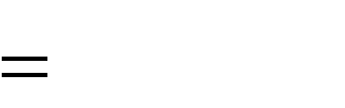
Root Mean Square Error
Measures the Accuracy of a Forecasting Method
(A F )²
t t
n
RMSE

Slide 37
Barometric Methods
National Bureau of Economic Research
Department of Commerce
Leading Indicators
Lagging Indicators
Coincident Indicators
Composite Index
Diffusion Index

Slide 38
Econometric Models
Single Equation Model of the Demand For Cereal (Good X)
Q_{X} = a₀ + a₁P_{X} + a₂Y + a₃N + a₄P_{S} + a₅P_{C} + a₆A + e
Q_{X} = Quantity of X P_{X} = Price of Good X
Y = Consumer Income N = Size of Population
P_{S} = Price of Muffins P_{C} = Price of Milk
A = Advertising
e = Random Error

Slide 39


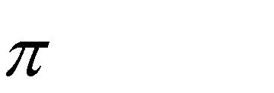


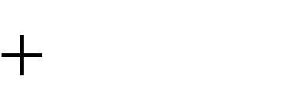
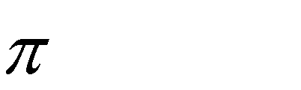


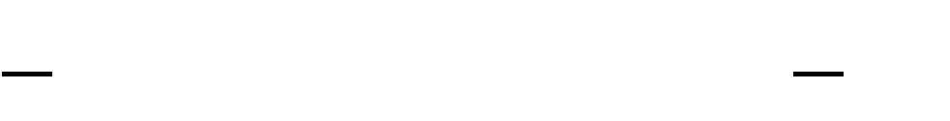
Econometric Models
Multiple Equation Model of GNP
C_{t} a₁
I_{t} a₂
GNP_{t} C_{t}
^{u}1t
^{b}2 t 1 ^{u}2t I_{t} G_{t}
b₁GNP_{t}
Reduced Form Equation
a₁ a₂ b₂
G_{t}
GNP
t 1
b
t
1 b
1
1
1 b
1
1

Slide 40
Input-Output Forecasting
Three-Sector Input-Output Flow Table
 | Producing Industry
Supplying Industry | A | B | C | Final Demand | Total
A | 20 | 60 | 30 | 90 | 200
B | 80 | 90 | 20 | 110 | 300
C | 40 | 30 | 10 | 20 | 100
Value Added | 60 | 120 | 40 |  | 220
Total | 200 | 300 | 100 | 220

Slide 41
Input-Output Forecasting
Direct Requirements Matrix
Direct Requirements
Input Requirements Column Total
=
 | Producing Industry
Supplying Industry | A | B | C
A | 0.1 | 0.2 | 0.3
B | 0.4 | 0.3 | 0.2
C | 0.2 | 0.1 | 0.1

Slide 42
Input-Output Forecasting
Total Requirements Matrix
 | Producing Industry
Supplying Industry | A | B | C
A | 1.47 | 0.51 | 0.60
B | 0.96 | 1.81 | 0.72
C | 0.43 | 0.31 | 1.33

Slide 43
Input-Output Forecasting
Total Requirements Matrix
Final Demand Vector
Total Demand Vector
1.47 | 0.51 | 0.60
0.96 | 1.81 | 0.72
0.43 | 0.31 | 1.33
90
110
20
200
300
100
=

Slide 44
Input-Output Forecasting
Revised Input-Output Flow Table
 | Producing Industry
Supplying Industry | A | B | C | Final Demand | Total
A | 22 | 62 | 31 | 100 | 215
B | 88 | 93 | 21 | 110 | 310
C | 43 | 31 | 10 | 20 | 104

Slide 45
TERIMA KASIH

