Slide 1

Energi Terbarukan
Pertemuan 4:
Nuklir
Dosen Pengampu:
Frida Hasana, S.Pd. M.Eng.

Slide 2
Nuclear Power
Acquired and Modified from:
Master of Electrical Engineering – UGM, Husni Rois Ali, , S.T., M.Eng., Ph.D., DIC., SMIEEE.

Slide 3
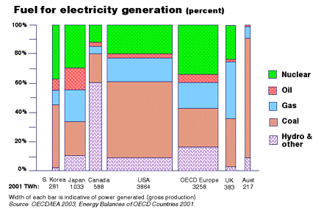
Current World Demand for Electricity

Slide 4
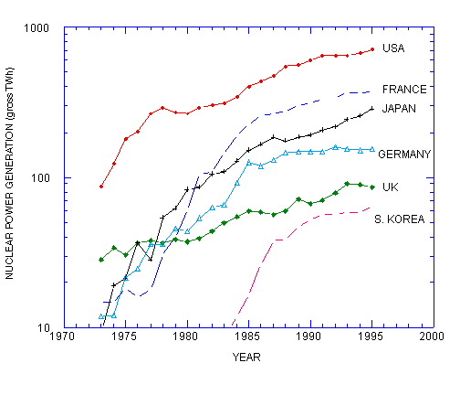
Past Demand by Country

Slide 5
U.S. Nuclear Plant Capacity Factors
http://www.nei.org/

Slide 6
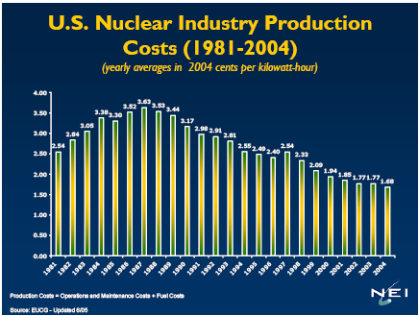
U.S. Nuclear Production Costs

Slide 7
U.S. Electricity Production Costs
(in constant 2004 cents/kWh )
Source: Energy Velocity / EUCG

Slide 8
Emission-Free Sources of Electricity
73.1%
24.2%
1.3%
1.0%
0.1%
Source: Energy Information Administration

Slide 9
Basics of a Power Plant
The basic premises for the majority of power plants is to:
  1) Create heat
  2) Boil Water
  3) Use steam to turn a turbine
  4) Use turbine to turn generator
  5) Produce Electricity
Some other power producing technologies work differently (e.g., solar, wind, hydroelectric, …)

Slide 10
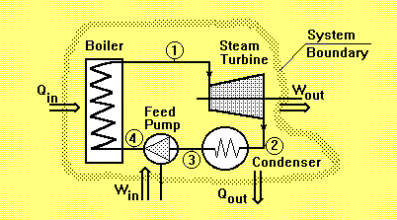
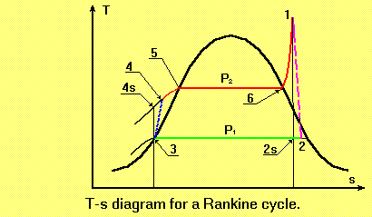
Nuclear Power Plants use the Rankine Cycle

Slide 11
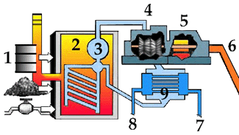
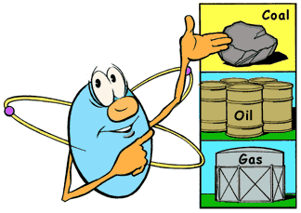
Create Heat
Heat may be created by:
  Burning coal
  Burning oil
  Other combustion
  Nuclear fission
1) oil, coal or gas
2) heat
3) steam
4) turbine
5) generator
6) electricity
7) cold water
8) waste heat water
9) condenser

Slide 12
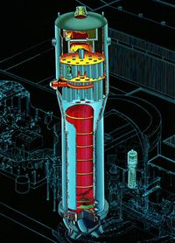
Boil Water
The next process it to create steam.
The steam is necessary to turn the turbine.
Westinghouse Steam Generator

Slide 13
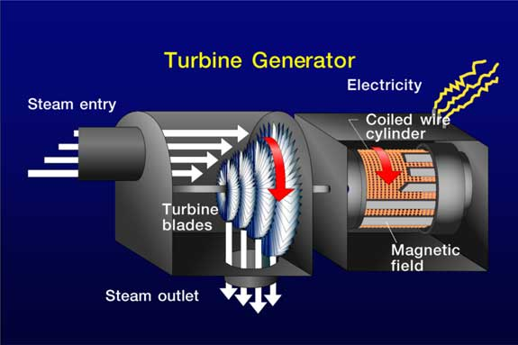
Turbine
Steam turns the turbine

Slide 14
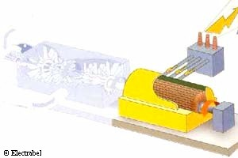
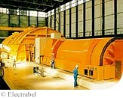
Generator
As the generator is turned, it creates electricity.

Slide 15
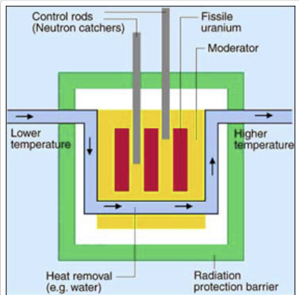
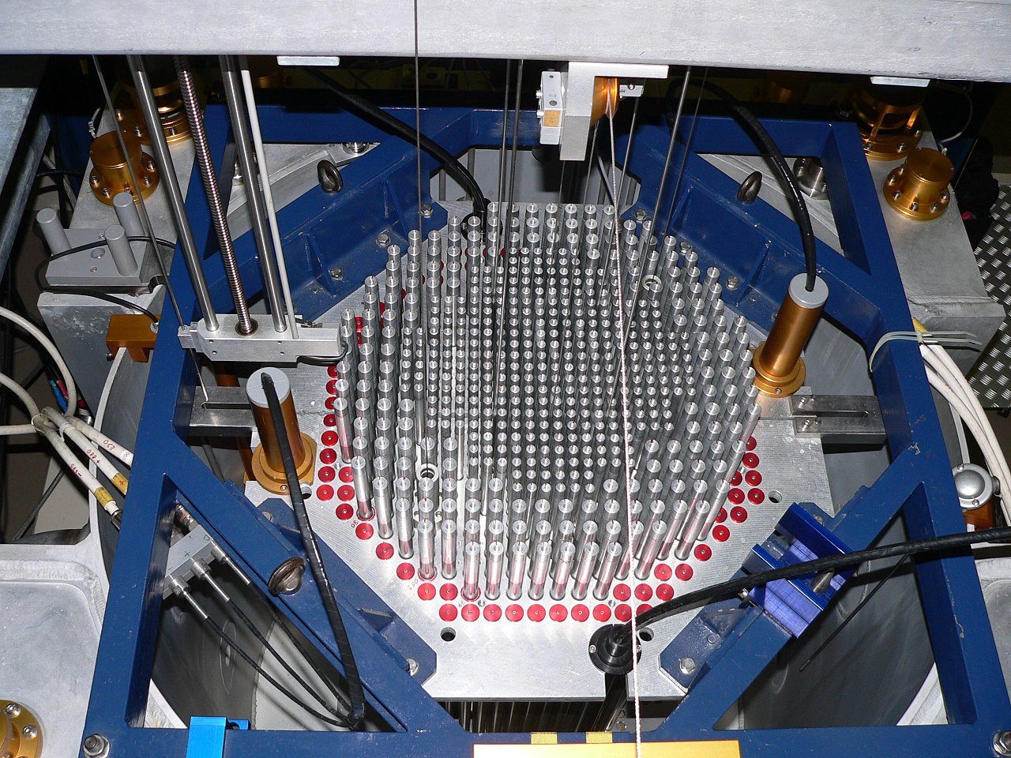
Nuclear reactor

Slide 16
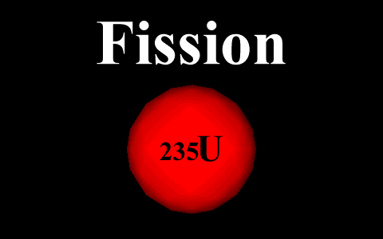
Heat From Fission

Slide 17
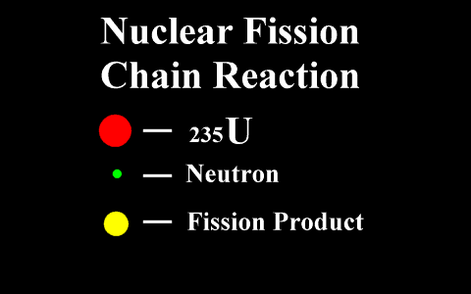
Fission Chain Reaction

Slide 18
Current Commercial Nuclear Reactor Designs
Pressurized Water Reactor (PWR)
Boiling Water Reactor (BWR)
Gas Cooled Fast Reactor
Pressurized Heavy Water Reactor (CANDU)
Light Water Graphite Reactor (RBMK)
Fast Neutron Reactor (FBR)

Slide 19
The Current Nuclear Industry

Slide 20
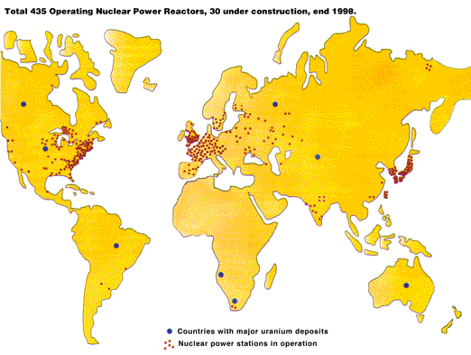
Nuclear Reactors Around the World

Slide 21
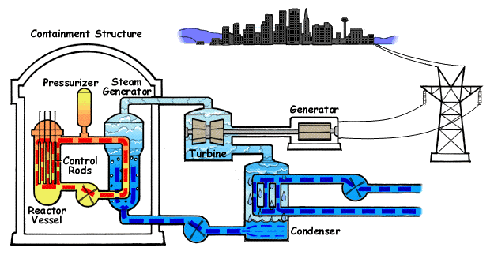
PWR

Slide 22
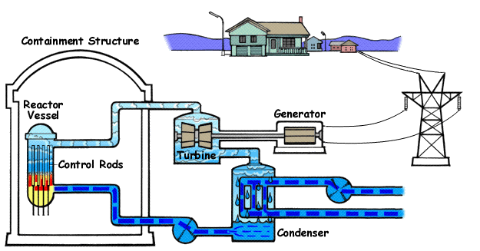
BWR

Slide 23
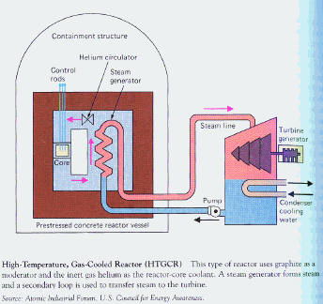
HTGR

Slide 24
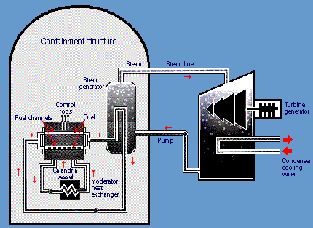
CANDU-PHWR
Deuterium oxide D2O

Slide 25
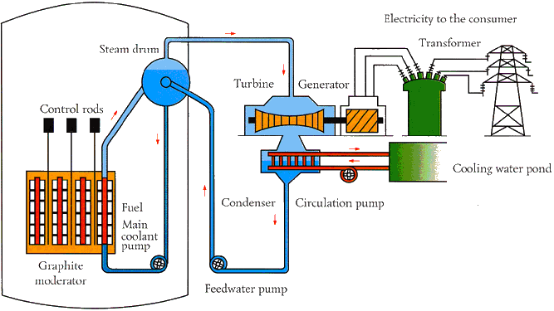
PTGR
Note: this is a RBMK reactor design as made famous at Chernoybl.

Slide 26
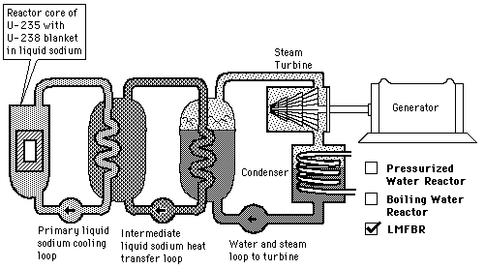
LMFBR

Slide 27
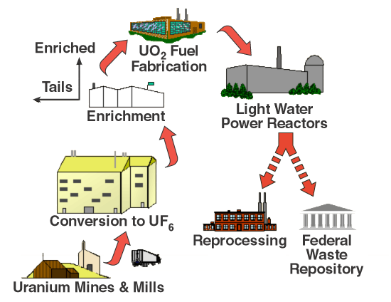
Nuclear Fuel Cycle
Uranium Mining and Milling
Conversion to UF₆
Enrichment
Fuel Fabrication
Power Reactors
Waste repository

Slide 28
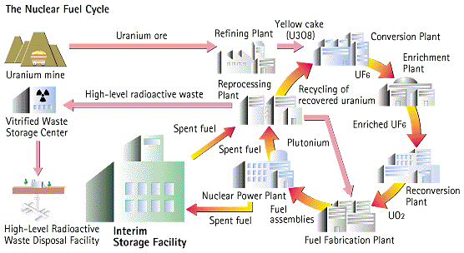
Nuclear Fuel Cycle with Reprocessing

Slide 29
Future Reactor Designs
Research is currently being conducted for design of the next generation of nuclear reactor designs.
The next generation designs focus on:
  Proliferation resistance of fuel
  Passive safety systems
  Improved fuel efficiency (includes breeding)
  Minimizing nuclear waste
  Improved plant efficiency (e.g., Brayton cycle)
  Hydrogen production
  Economics

Slide 30
Policy Issues
Many policy issues exist that affect the viability of the future of nuclear power:
  Licensing
  Risk insurance
  Reprocessing of spent nuclear fuel
  Nuclear waste repository
  Next generation reactor research
  Incorporation of hydrogen production into nuclear fuel cycle
  University nuclear engineering programs

Slide 31
Conclusions
So, what does the future hold?
  The demand for electrical power will continue to increase.
  The world reserves of fossil fuels are limited.
  Modern nuclear power plant designs are more inherently safe and may be constructed with less capital cost.
  Fossil fuel-based electricity is projected to account for more than 40% of global greenhouse gas emissions by 2020.
A 2003 study by MIT predicted that nuclear power growth of three fold will be necessary by 2050.
U.S. Government has voiced strong support for nuclear power production.

Slide 32
END
32

