Slide 1

Energi Terbarukan
Pertemuan 2:
Solar PV
Dosen Pengampu:
Frida Hasana, S.Pd. M.Eng.

Slide 2
Solar PV
Modified from:
Master of Electrical Engineering – UGM
Ir. Lesnanto Multa Putranto, S.T., M.Eng., Ph.D., IPM., SMIEEE.

Slide 3
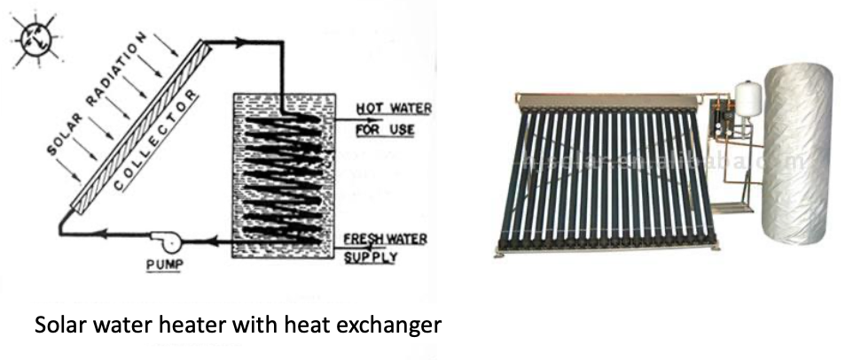
Solar Domestic Hot Water

Slide 4
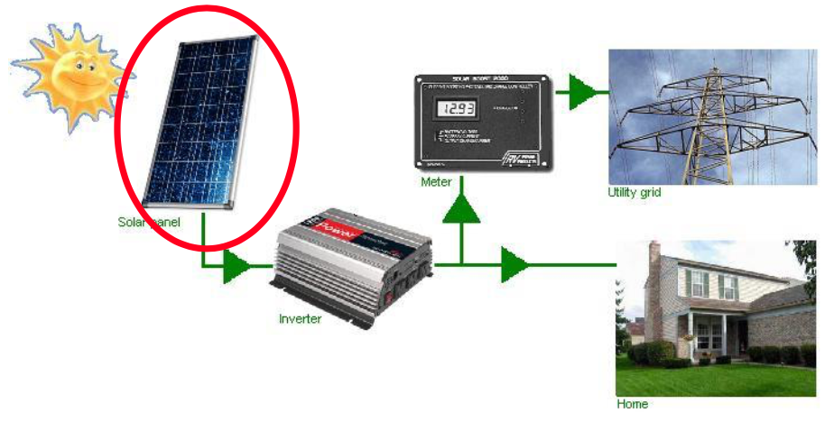
Solar PV System On Grid
Solar PV rooftop
Solar PV farm

Slide 5
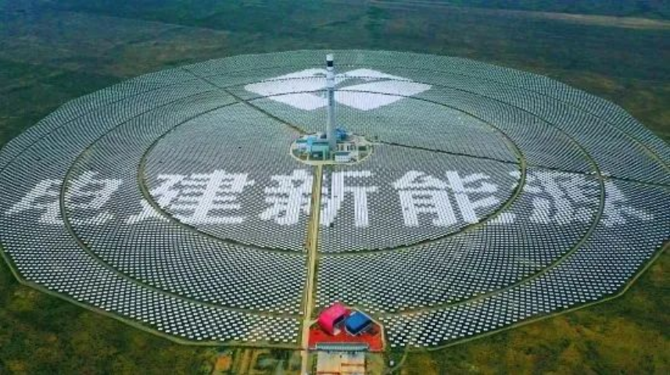
Gonghe Talatan Solar Park stands as the undisputed champion of solar installations worldwide. The site spreads over 609 km² (almost equivalent to Singapore’s land area). This massive complex, located in China’s Qinghai Province, has been developed in multiple phases since 2011, with continuous expansion pushing its capacity to an astounding 15.6 GW. The facility includes over 7.2 million solar panels and incorporates various panel designs for testing and optimization purposes.

Slide 6
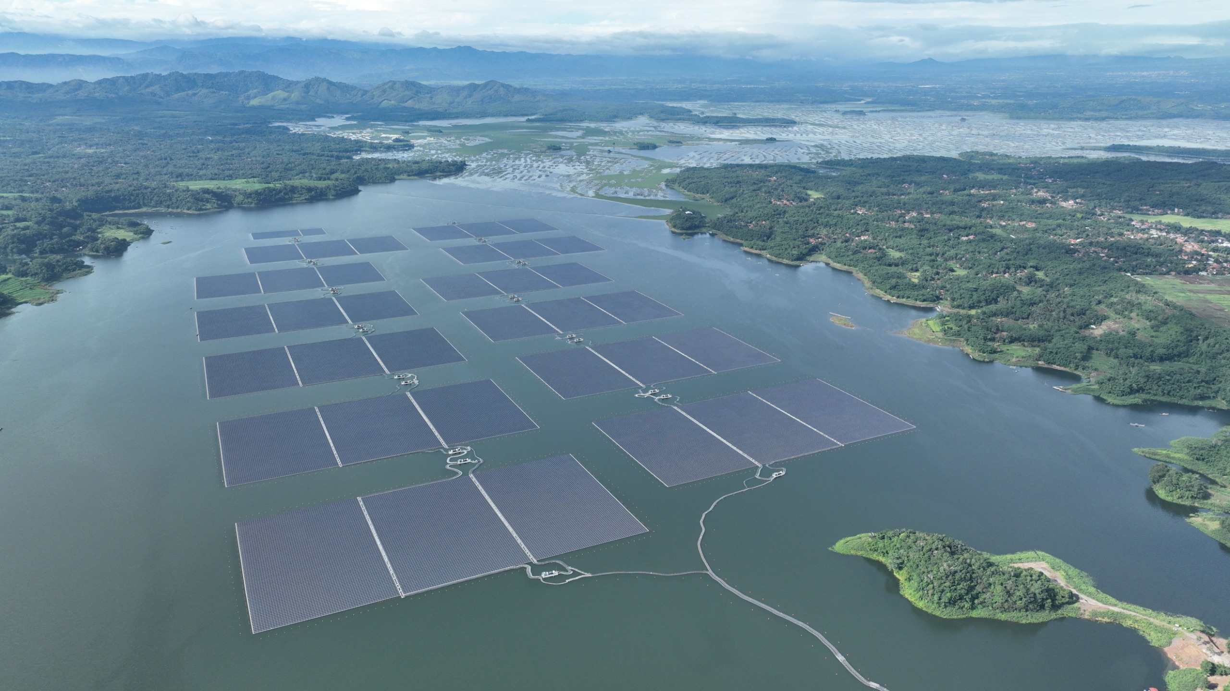
The largest solar power plant in Indonesia is currently the Cirata Floating Solar Plant in Purwakarta, West Java. It has an installed capacity of 192 MWp, occupying about 250 hectares over the Cirata Reservoir, and is capable of powering over 50,000 households annually. Developed through a collaboration involving PLN and Masdar, it is also Southeast Asia’s largest floating solar plant.
(The Jakarta Post)

Slide 7
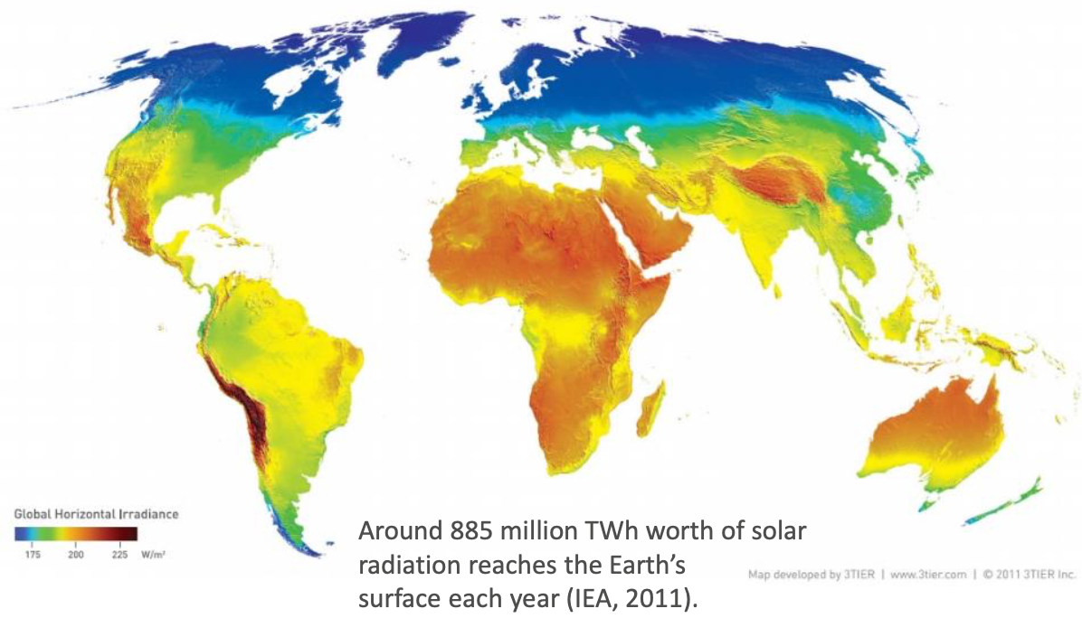
Global Mean Solar Irradiance

Slide 8
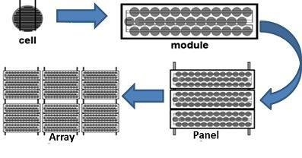
Photovoltaic (PV) Hierarchy
Cell < Module < Panel < Array

Slide 9
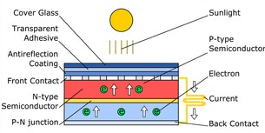
Inside of PV Cell
Solar cells consist of two layers of semiconductor material with opposite charges. Sunlight hitting the surface of a cell causes electrons to be knocked loose, which then travel through a circuit from one layer to the other, generating a flow of electricity.

Slide 10
PV SYSTEMS TECHNOLOGIES

Slide 11
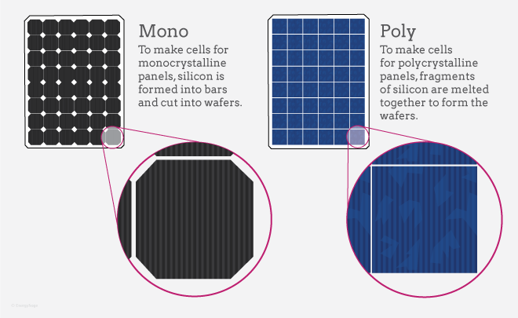
PV Systems Technology
1st Generation
Crystalline silicon cells are classified into three main types depending on how the Si wafers are made :
  Monocrystalline (Mono c-Si), sometimes also called single crystalline (sc-Si)
  Polycrystalline (Poly c-Si), sometimes referred to as multi-crystalline (mc-Si)
  EFG ribbon silicon and silicon sheet-defined film growth (EFG ribbon-sheet c-Si)
The manufacturing process of wafer-based silicon PV modules comprises four steps:
Polysilicon production;
Polysilicon production;
Ingot/wafer production;
Cell production; and
Module assembly.

Slide 12
1st Generation
Monocrystalline Modules
Most efficient commercially available module (11% - 14%)
Most expensive to produce
Circular (square-round) cell creates wasted space on module.
Polycrystalline Silicon Modules
Less expensive to produce than single crystalline modules.
Cells are slightly less efficient than single crystalline ones (10% - 12%).
Square-shaped cells fit into the module efficiently, using the entire space.

Slide 13
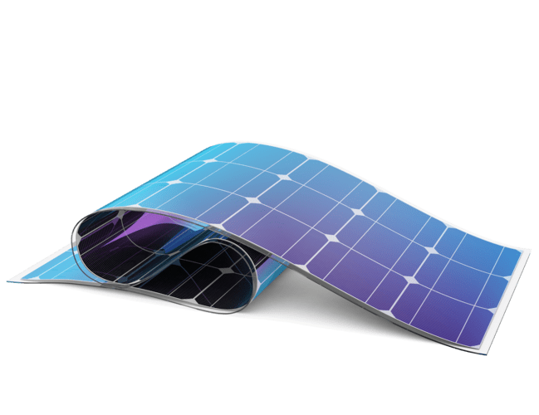
PV Systems Technology
2nd Generation: Thin Film
Require a lot less semiconductor material to manufacture in order to absorb the same amount of sunlight (up to 99% less material than crystalline solar cells).
Thin films can be packaged into flexible and lightweight structures, which can be easily integrated into building components.
The three primary types of thin-film solar cells that have been commercially developed are:
  Amorphous silicon (a-Si and a-Si/μc-Si);
  Cadmium Telluride (Cd-Te); and
  Copper-Indium-Selenide (CIS) and Copper-Indium-Gallium-Diselenide (CIGS).

Slide 14
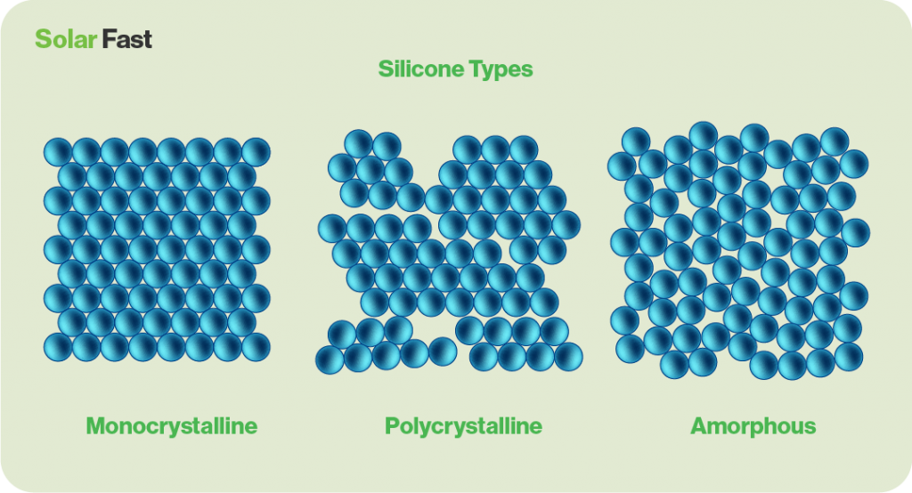
2nd Generation: Thin Film
Amorphous Thin Film
Most inexpensive technology to produce
Metal grid replaced with transparent oxides
Efficiency = 6 – 8 %
Can be deposited on flexible substrates
Less susceptible to shading problems
Better performance in low light conditions that with crystalline modules

Slide 15
PV Systems Technology
3rd Generation
There are four types of third-generation PV technologies:
Concentrating PV (CPV);
  Utilise optical devices, such as lenses or mirrors, to concentrate direct solar radiation onto very small, highly efficient multi-junction solar cells made of a semiconductor material.
  The sunlight concentration factor ranges from 2 to 100 suns (low-to medium-concentration) up to 1000 suns (high concentration).
Dye-sensitized solar cells (DSSC);
  Use photo-electrochemical solar cells, which are based on semiconductor structures formed between a photo-sensitised anode and an electrolyte.
  Use low-cost materials and are simple to manufacture.
Organic solar cells;
  composed of organic or polymer materials (such as organic polymers or
small organic molecules); inexpensive but not efficient
Novel and emerging solar cell concepts.

Slide 16
Selecting the Correct Module
Practical Criteria
  Size
  Voltage
  Availability
  Warranty
  Mounting Characteristics
  Cost (per watt)

Slide 17
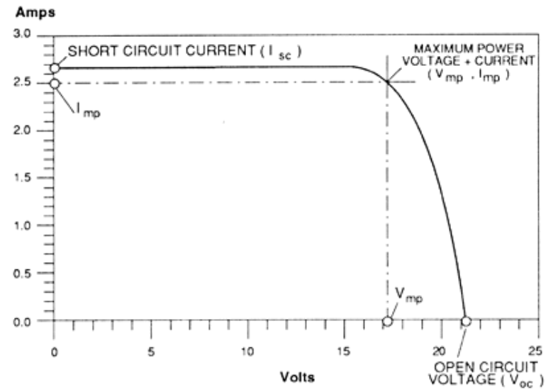
Current Voltage (I-V) Curve

Slide 18
Current Voltage (I-V) Curve
I_{sc} (Short Circuit Current)
  The point where voltage= 0 (short circuit)
V_{oc} (Open Circuit Voltage)
  The point where current = 0 (open circuit)
P_{max} (Maximum Power)
  Pmax​ = Vmp ​× Imp​
MPPT (Maximum Power Point Tracking)
  Optimizes and stabilizes the system to always operate at Vmp and Imp

Slide 19
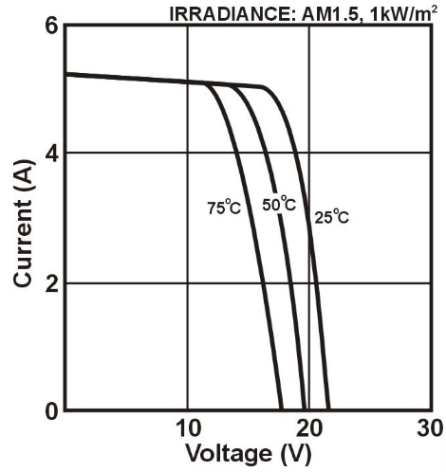
Effect of Temperature
As the PV cell temperature increases above 25⁰C, the module Vmp decreases by approximately 0.5% per ⁰C
PV cell produces power supplied by irradiance, not by temperature

Slide 20
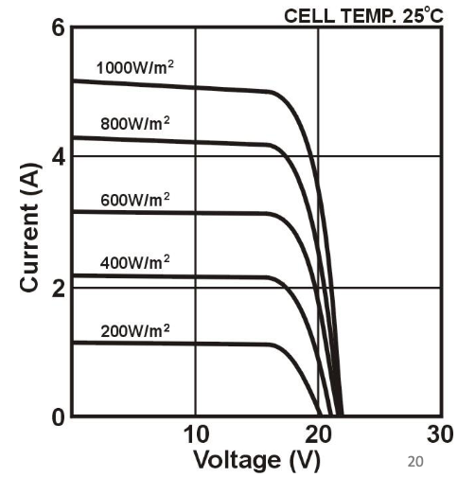
Effect of Shading/Low Insolation
As insolation increases, amperage increases while voltage remains roughly constant

Slide 21
PV WIRING

Slide 22
Solar PV System On Grid

Slide 23
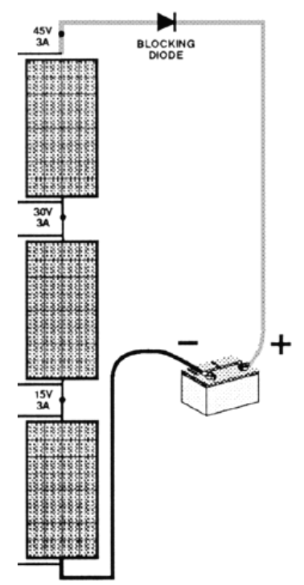
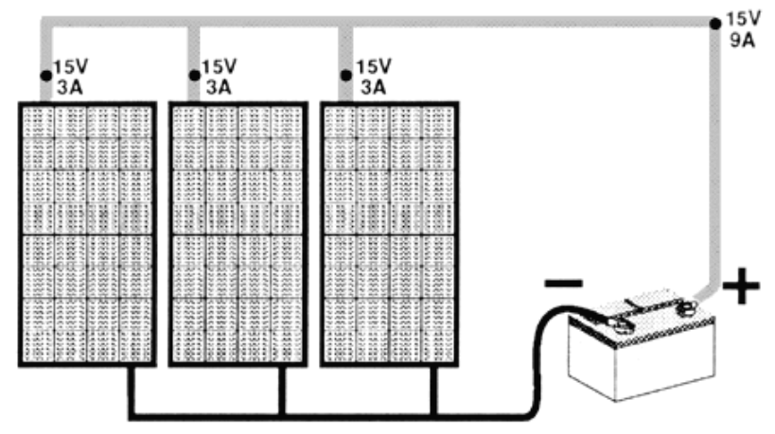
PV WIRING
Loads/sources wired in series
VOLTAGES ARE ADDITIVE
CURRENT IS EQUAL
Loads/sources wired in parallel
VOLTAGE REMAINS CONSTANT
CURRENTS ARE ADDITIVE

Slide 24
PV ANGEL
&
MOUNTING

Slide 25
Solar Energy Source
Understand azimuth and altitude
Describe the proper orientation and tilt angle for solar collection
Describe the concept of “solar window”
Evaluate structural considerations
Pros and cons of different mounting techniques

Slide 26
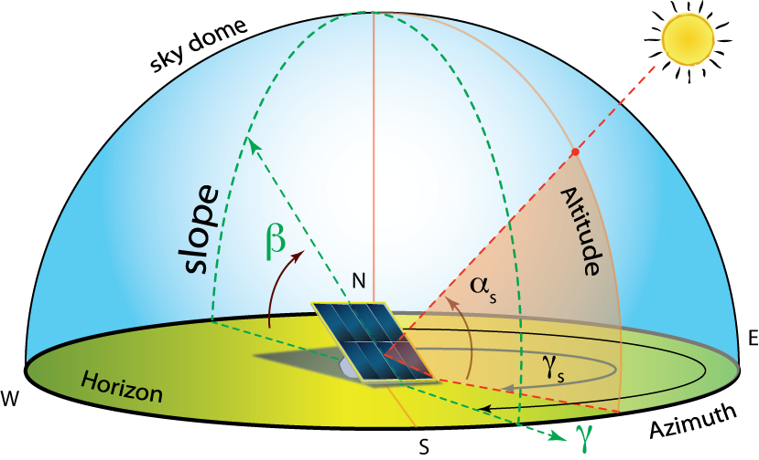
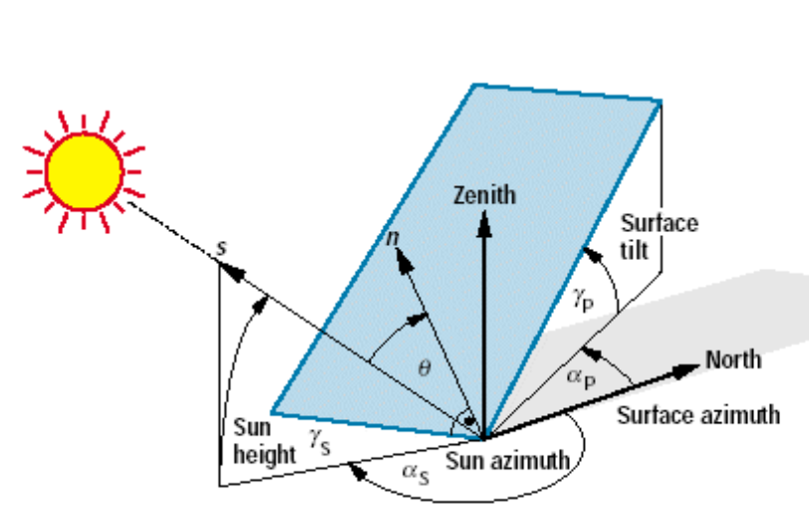
Panel Direction
Altitude (sun elevation)
Azimuth (sun direction)
Tilt (solar panel tilt)
Solar Access
Optimum Solar Window 9 am – 3 pm
Max performance is achieved when panels are perpendicular to the sun’s rays
Array should have NO SHADING in this window (or longer if possible)

Slide 27
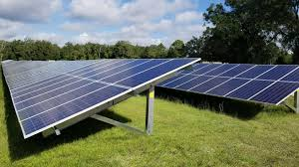
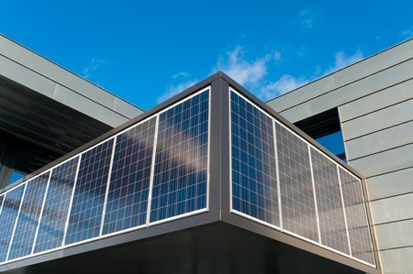
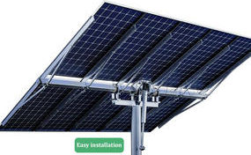
Basic Mounting
FIXED
INTEGRATED
TRACKING
Roof
Ground
Pole
Pole Active
Pole Pasive

Slide 28
END

