Slide 1
Transformasi Laplace
Matematika II
Fauzhia Rahmasari, S.Si, M.Si

Slide 2
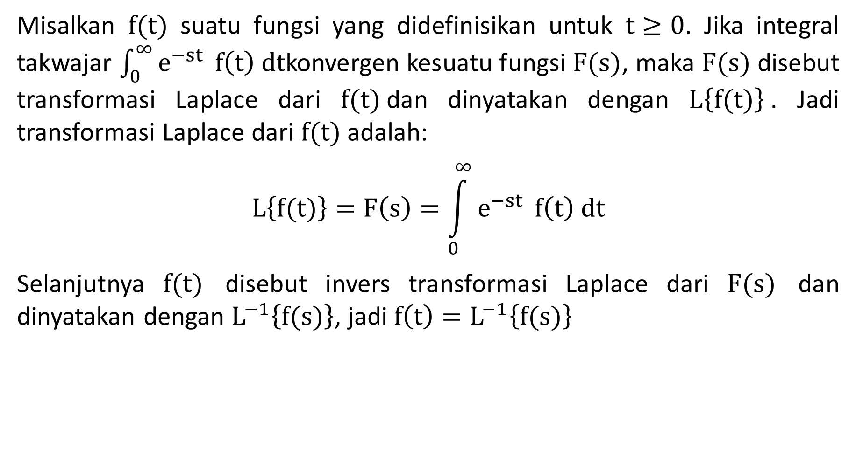
Definisi
Misalkan $f(t)$ suatu fungsi yang didefinisikan untuk $t≥0$. Jika integral takwajar $\int_{0}^{∞}{e^{−st}} f\left(t\right) dt$konvergen kesuatu fungsi $F(s)$, maka $F(s)$ disebut transformasi Laplace dari $f(t)$dan dinyatakan dengan $L\left\{f(t)\right\}$. Jadi transformasi Laplace dari $f(t)$ adalah:
$$L\left\{f(t)\right\}=F\left(s\right)=\int_{0}^{∞}{e^{−st}} f\left(t\right) dt$$
Selanjutnya $f(t)$ disebut invers transformasi Laplace dari $F(s)$ dan dinyatakan dengan $L^{−1}\left\{f(s)\right\}$, jadi $f\left(t\right)=L^{−1}\left\{f(s)\right\}$

Slide 3
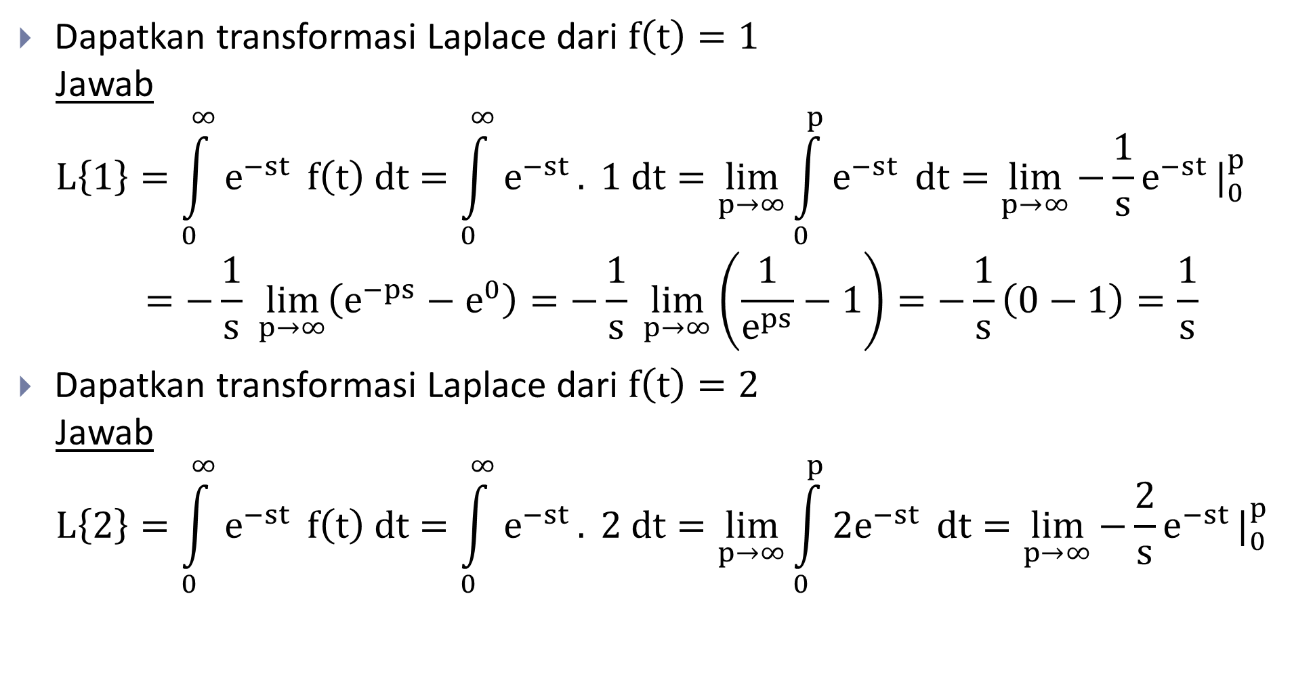
Transformasi Laplace
Dapatkan transformasi Laplace dari $f\left(t\right)=1$
Jawab
$$L\left\{1\right\}=\int_{0}^{∞}{e^{−st}} f\left(t\right) dt=\int_{0}^{∞}{e^{−st}}. 1 dt=\lim_{p→∞}{\int_{0}^{p}{e^{−st}}} dt=\lim_{p→∞}{−\frac{1}{s}e^{−st}}|_{0}^{p}$$
$$=−\frac{1}{s} \lim_{p→∞}\left(e^{−ps}−e^{0}\right)=−\frac{1}{s} \lim_{p→∞}\left(\frac{1}{e^{ps}}−1\right)=−\frac{1}{s}\left(0−1\right)=\frac{1}{s}$$
Dapatkan transformasi Laplace dari $f\left(t\right)=2$
Jawab
$$L\left\{2\right\}=\int_{0}^{∞}{e^{−st}} f\left(t\right) dt=\int_{0}^{∞}{e^{−st}}. 2 dt=\lim_{p→∞}{\int_{0}^{p}{{2e}^{−st}}} dt=\lim_{p→∞}{−\frac{2}{s}e^{−st}}|_{0}^{p}$$

Slide 4

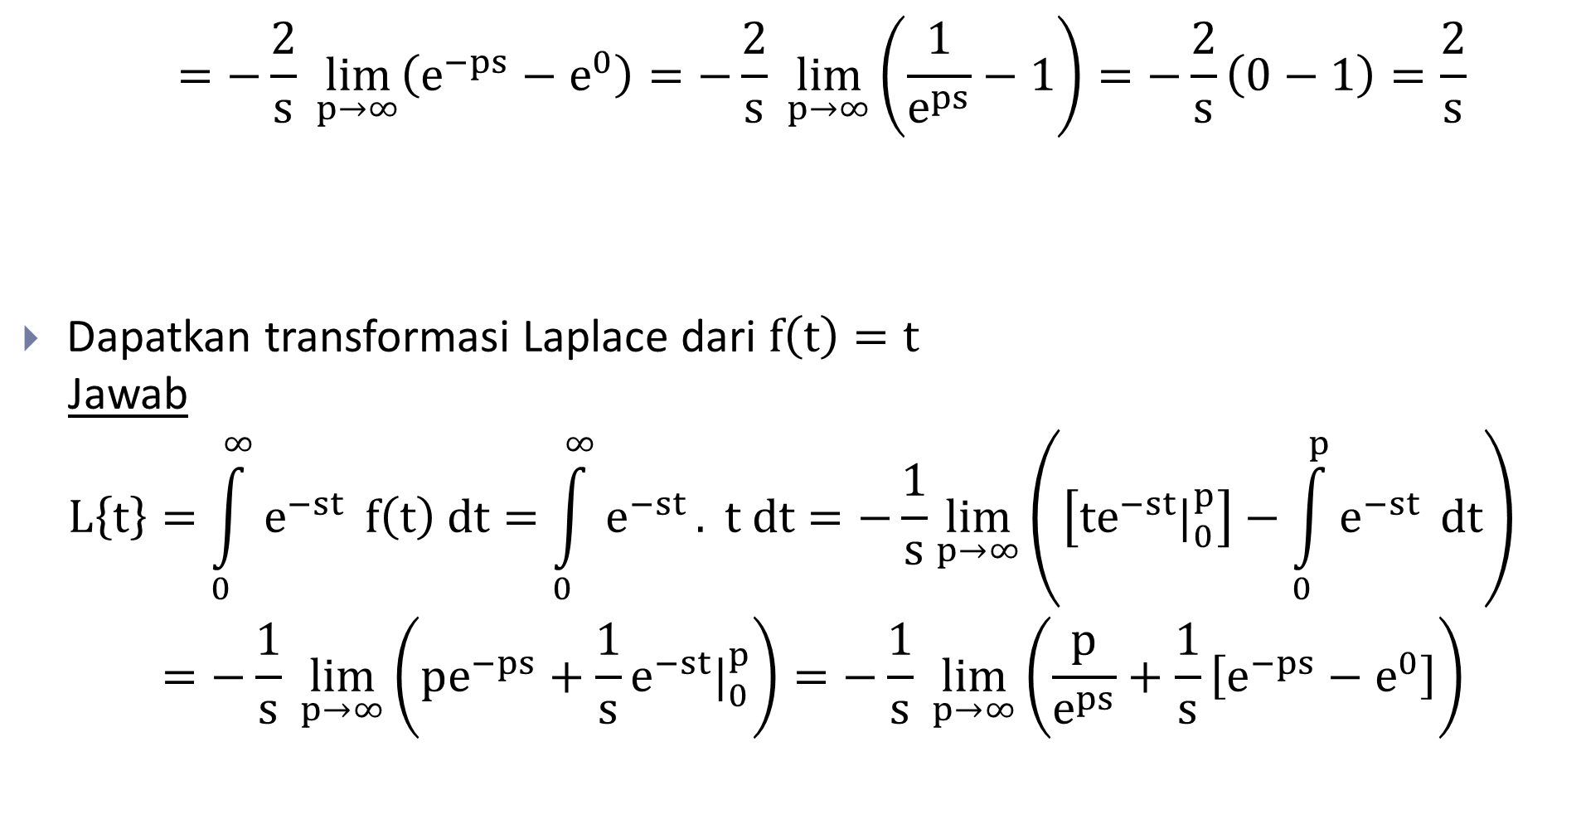
Transformasi Laplace
$$=−\frac{2}{s} \lim_{p→∞}\left(e^{−ps}−e^{0}\right)=−\frac{2}{s} \lim_{p→∞}\left(\frac{1}{e^{ps}}−1\right)=−\frac{2}{s}\left(0−1\right)=\frac{2}{s}$$
Dapatkan transformasi Laplace dari $f\left(t\right)=t$
Jawab
$$L\left\{t\right\}=\int_{0}^{∞}{e^{−st}} f\left(t\right) dt=\int_{0}^{∞}{e^{−st}}. t dt=−\frac{1}{s}\lim_{p→∞}\left(\left[te^{−st}|_{0}^{p}\right]−\int_{0}^{p}{e^{−st}} dt\right)$$
$$=−\frac{1}{s} \lim_{p→∞}\left(pe^{−ps}+\frac{1}{s}e^{−st}|_{0}^{p}\right)=−\frac{1}{s} \lim_{p→∞}\left(\frac{p}{e^{ps}}+\frac{1}{s}\left[e^{−ps}−e^{0}\right]\right)$$
Kesimpulan: Jika $c$ konstanta, maka $L\left\{c\right\}=\frac{c}{s}$

Slide 5
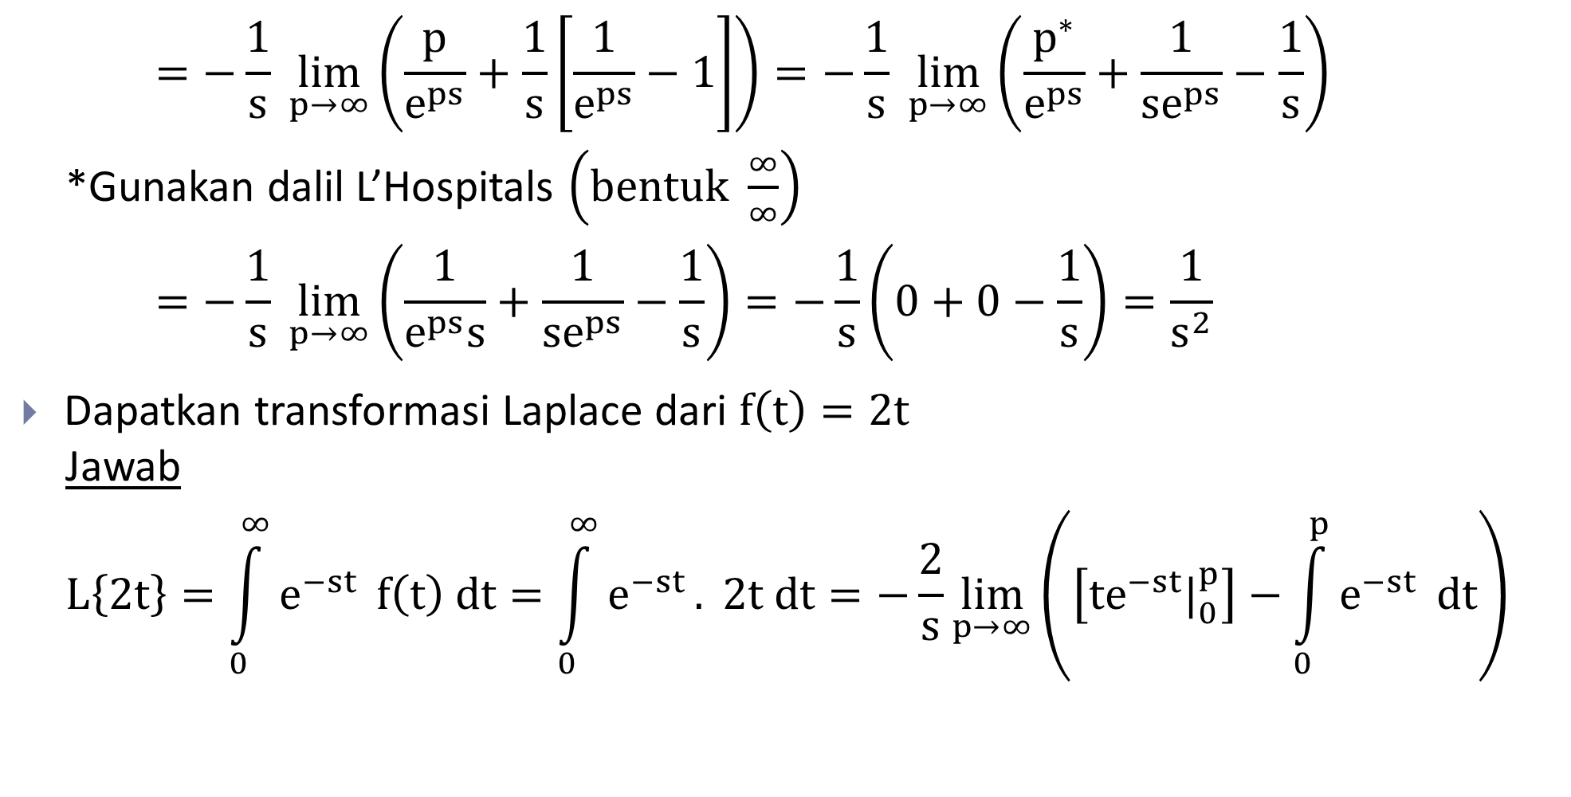
Transformasi Laplace
$$=−\frac{1}{s} \lim_{p→∞}\left(\frac{p}{e^{ps}}+\frac{1}{s}\left[\frac{1}{e^{ps}}−1\right]\right)=−\frac{1}{s} \lim_{p→∞}\left(\frac{p^{∗}}{e^{ps}}+\frac{1}{se^{ps}}−\frac{1}{s}\right)$$
*Gunakan dalil L’Hospitals $\left(bentuk \frac{∞}{∞}\right)$
$$=−\frac{1}{s} \lim_{p→∞}\left(\frac{1}{e^{ps}s}+\frac{1}{se^{ps}}−\frac{1}{s}\right)=−\frac{1}{s}\left(0+0−\frac{1}{s}\right)=\frac{1}{s^{2}}$$
Dapatkan transformasi Laplace dari $f\left(t\right)=2t$
Jawab
$$L\left\{2t\right\}=\int_{0}^{∞}{e^{−st}} f\left(t\right) dt=\int_{0}^{∞}{e^{−st}}. 2t dt=−\frac{2}{s}\lim_{p→∞}\left(\left[te^{−st}|_{0}^{p}\right]−\int_{0}^{p}{e^{−st}} dt\right)$$

Slide 6
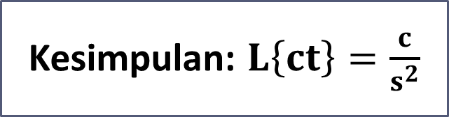
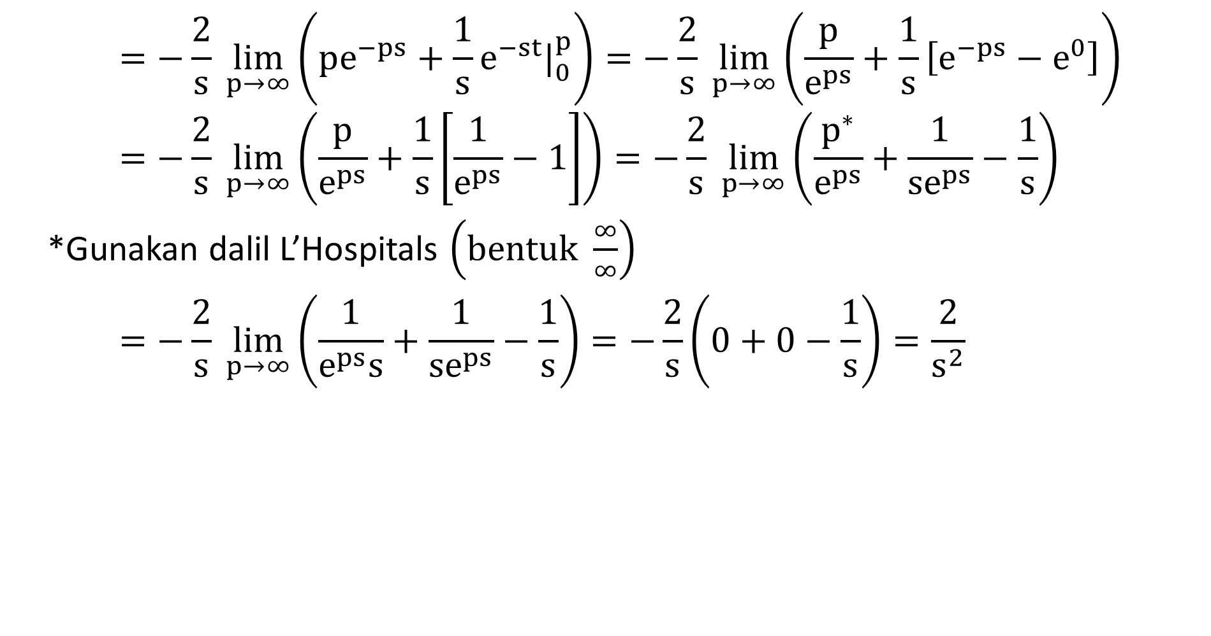
Transformasi Laplace
$$=−\frac{2}{s} \lim_{p→∞}\left(pe^{−ps}+\frac{1}{s}e^{−st}|_{0}^{p}\right)=−\frac{2}{s} \lim_{p→∞}\left(\frac{p}{e^{ps}}+\frac{1}{s}\left[e^{−ps}−e^{0}\right]\right)$$
$$=−\frac{2}{s} \lim_{p→∞}\left(\frac{p}{e^{ps}}+\frac{1}{s}\left[\frac{1}{e^{ps}}−1\right]\right)=−\frac{2}{s} \lim_{p→∞}\left(\frac{p^{∗}}{e^{ps}}+\frac{1}{se^{ps}}−\frac{1}{s}\right)$$
*Gunakan dalil L’Hospitals $\left(bentuk \frac{∞}{∞}\right)$
$$=−\frac{2}{s} \lim_{p→∞}\left(\frac{1}{e^{ps}s}+\frac{1}{se^{ps}}−\frac{1}{s}\right)=−\frac{2}{s}\left(0+0−\frac{1}{s}\right)=\frac{2}{s^{2}}$$
Kesimpulan: $L\left\{ct\right\}=\frac{c}{s^{2}}$

Slide 7
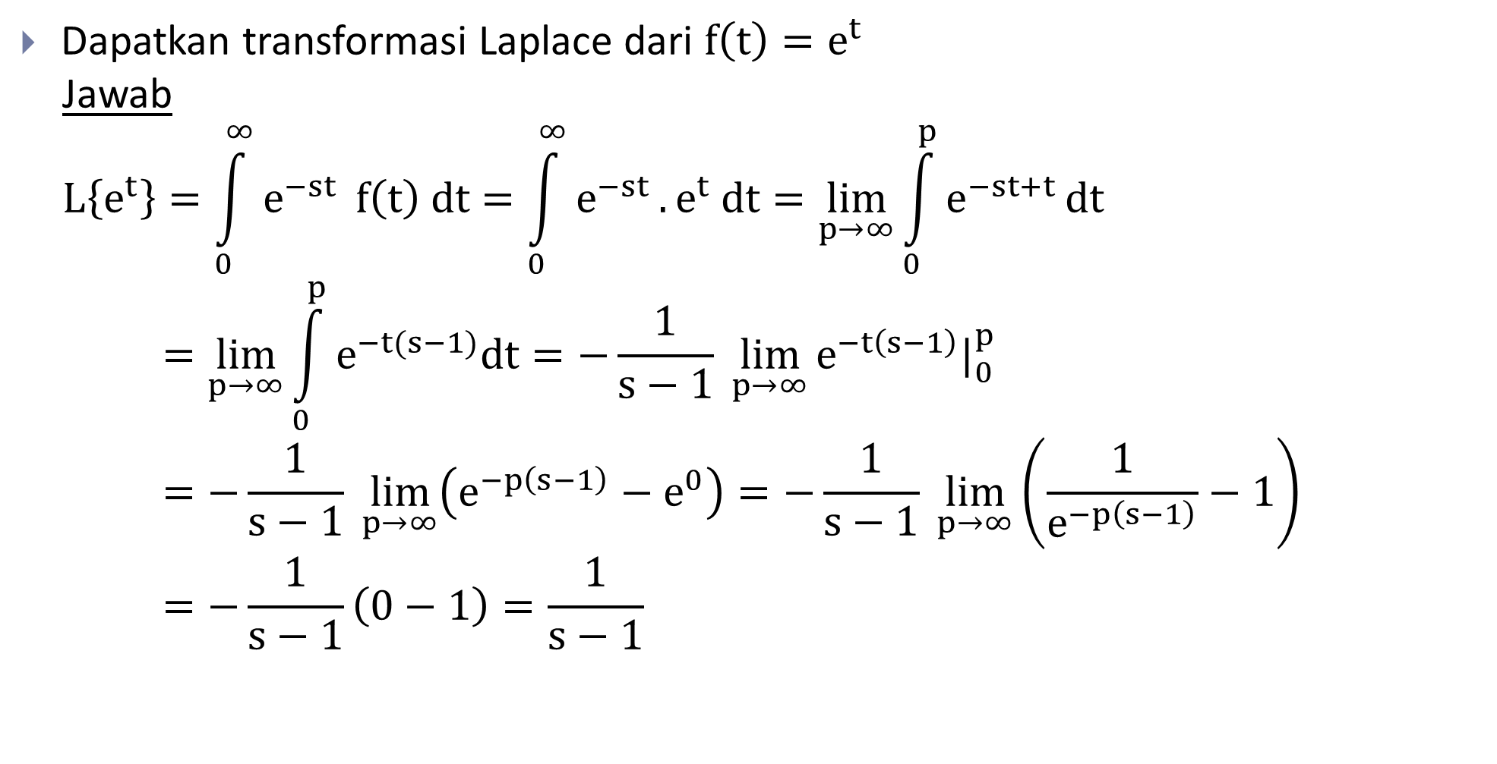
Transformasi Laplace
Dapatkan transformasi Laplace dari $f\left(t\right)=e^{t}$
Jawab
$$L\left\{e^{t}\right\}=\int_{0}^{∞}{e^{−st}} f\left(t\right) dt=\int_{0}^{∞}{e^{−st}}. e^{t} dt=\lim_{p→∞}{\int_{0}^{p}{e^{−st+t}}}dt$$
$$=\lim_{p→∞}{\int_{0}^{p}{e^{−t(s−1)}dt}}=−\frac{1}{s−1} \lim_{p→∞}{e^{−t\left(s−1\right)}|_{0}^{p}}=−\frac{1}{s−1} \lim_{p→∞}\left(e^{−p\left(s−1\right)}−e^{0}\right)=−\frac{1}{s−1} \lim_{p→∞}\left(\frac{1}{e^{−p\left(s−1\right)}}−1\right)=−\frac{1}{s−1}\left(0−1\right)=\frac{1}{s−1}$$

Slide 8

Transformasi Laplace
Dapatkan transformasi Laplace dari $f\left(t\right)=e^{2t}$
Jawab
$$L\left\{e^{2t}\right\}=\int_{0}^{∞}{e^{−st}} f\left(t\right) dt=\int_{0}^{∞}{e^{−st}}. e^{2t} dt=\lim_{p→∞}{\int_{0}^{p}{e^{−st+2t}}}dt$$
$$=\lim_{p→∞}{\int_{0}^{p}{e^{−t(s−2)}dt}}=−\frac{1}{s−2} \lim_{p→∞}{e^{−t\left(s−2\right)}|_{0}^{p}}=−\frac{1}{s−2} \lim_{p→∞}\left(e^{−p\left(s−2\right)}−e^{0}\right)=−\frac{1}{s−2} \lim_{p→∞}\left(\frac{1}{e^{−p\left(s−2\right)}}−1\right)=−\frac{1}{s−2}\left(0−1\right)=\frac{1}{s−2}$$

Slide 9
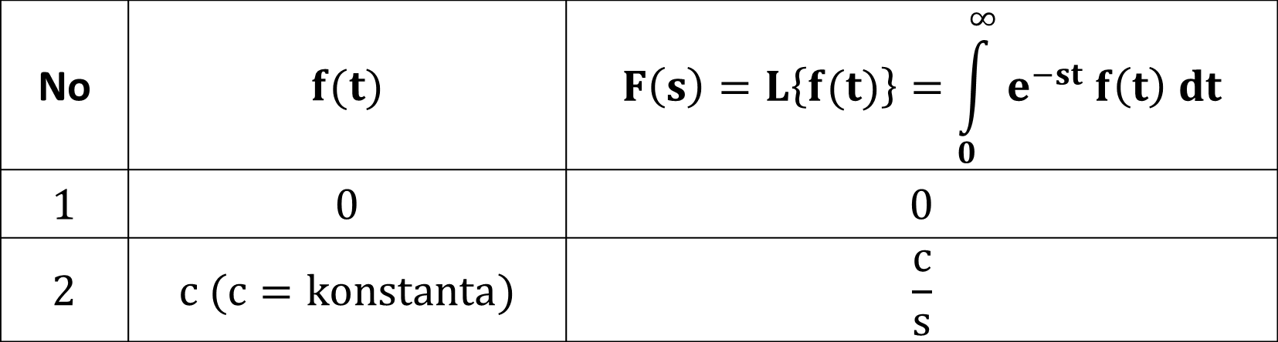

Transformasi Laplace
Berikut transformasi Laplace dari beberapa fungsi (dalam tabel):
Kesimpulan: $L\left\{e^{at}\right\}=\frac{1}{s−a}$
No | $$f(t)$$ | $$F\left(s\right)=L\left\{f(t)\right\}=\int_{0}^{∞}{e^{−st} f\left(t\right) dt}$$
$$1$$ | $$0$$ | $$0$$
$$2$$ | $$c (c=konstanta)$$ | $$\frac{c}{s}$$

Slide 10
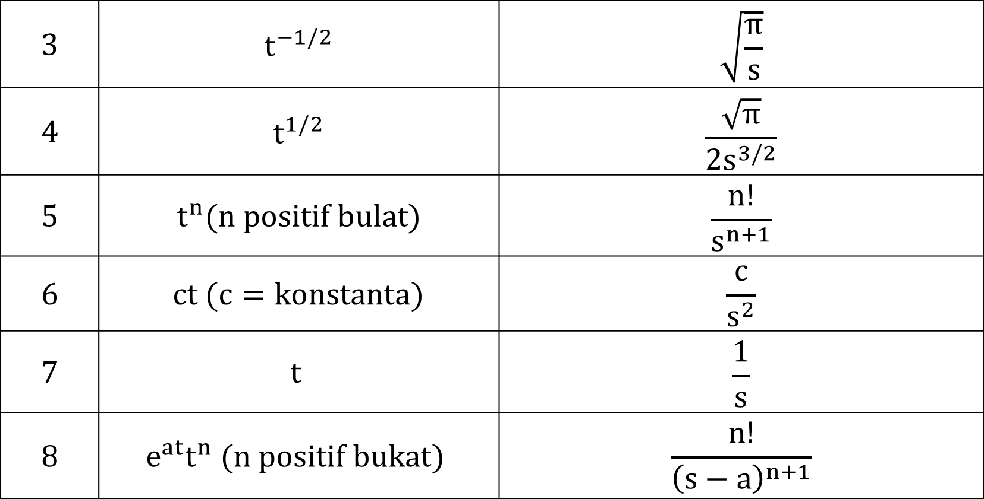
Transformasi Laplace
$$3$$ | $$t^{−1/2}$$ | $$\sqrt{\frac{π}{s}}$$
$$4$$ | $$t^{1/2}$$ | $$\frac{\sqrt{π}}{{2s}^{3/2}}$$
$$5$$ | $$t^{n}(n positif bulat)$$ | $$\frac{n!}{s^{n+1}}$$
$$6$$ | $$ct (c=konstanta)$$ | $$\frac{c}{s^{2}}$$
$$7$$ | $$t$$ | $$\frac{1}{s}$$
$$8$$ | $$e^{at}t^{n} (n positif bukat)$$ | $$\frac{n!}{{\left(s−a\right)}^{n+1}}$$

Slide 11
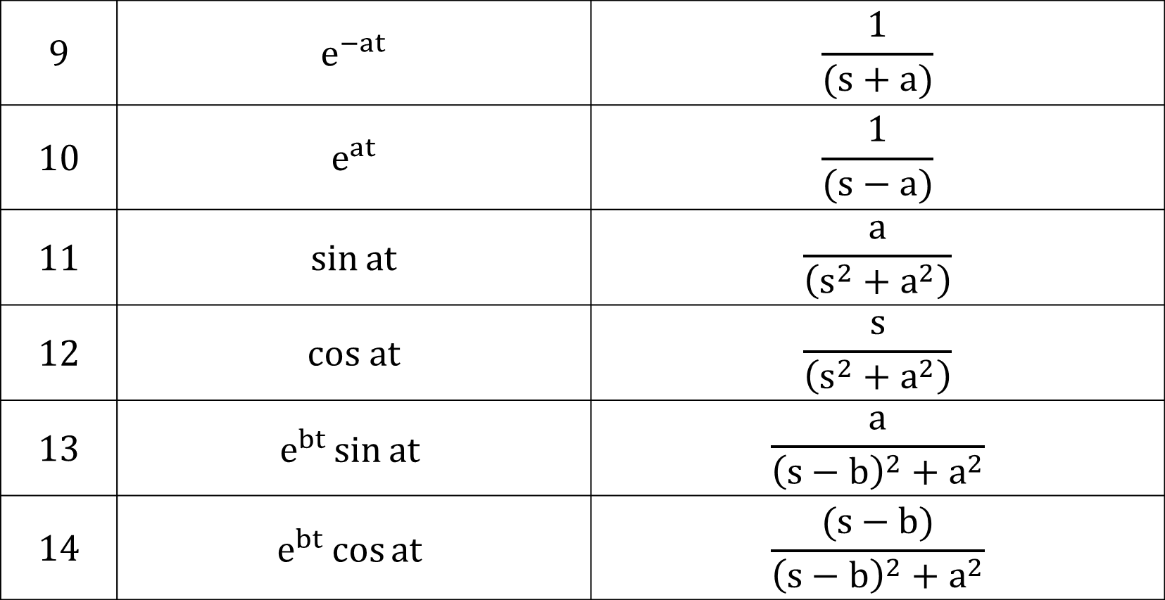
Transformasi Laplace
$$9$$ | $$e^{−at}$$ | $$\frac{1}{(s+a)}$$
$$10$$ | $$e^{at}$$ | $$\frac{1}{(s−a)}$$
$$11$$ | $$\sin{at}$$ | $$\frac{a}{\left(s^{2}+a^{2}\right)}$$
$$12$$ | $$cos at$$ | $$\frac{s}{\left(s^{2}+a^{2}\right)}$$
$$13$$ | $$e^{bt}\sin{at}$$ | $$\frac{a}{{\left(s−b\right)}^{2}+a^{2}}$$
$$14$$ | $$e^{bt}\cos{at}$$ | $$\frac{(s−b)}{{\left(s−b\right)}^{2}+a^{2}}$$

Slide 12
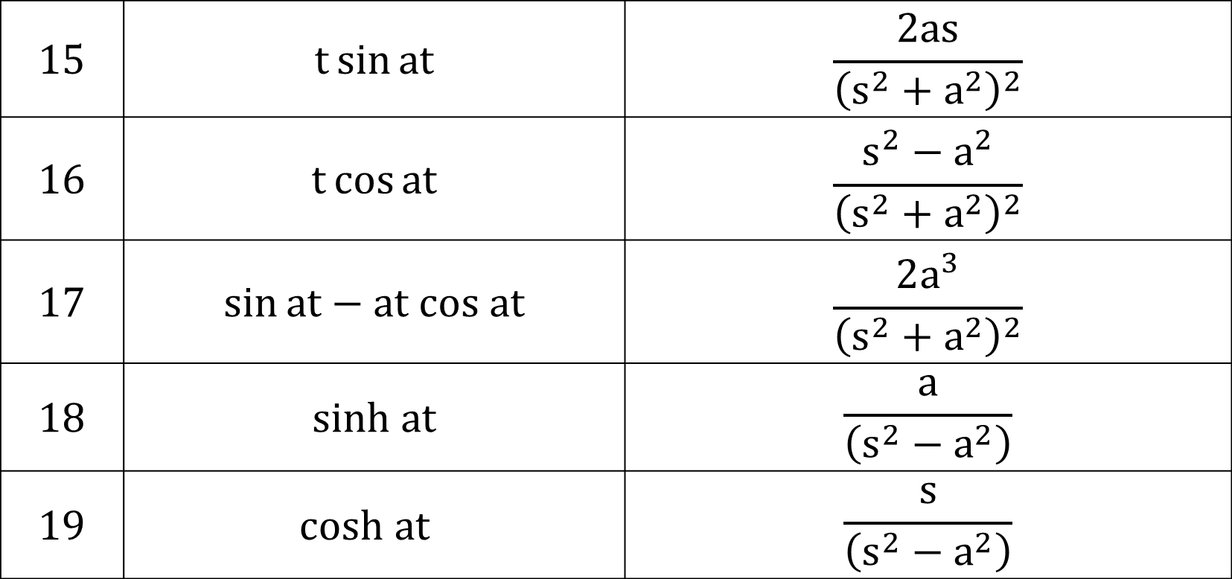
Transformasi Laplace
$$15$$ | $$t\sin{at}$$ | $$\frac{2as}{{\left(s^{2}+a^{2}\right)}^{2}}$$
$$16$$ | $$t\cos{at}$$ | $$\frac{s^{2}−a^{2}}{{\left(s^{2}+a^{2}\right)}^{2}}$$
$$17$$ | $$\sin{at−at cos at}$$ | $$\frac{2a^{3}}{{\left(s^{2}+a^{2}\right)}^{2}}$$
$$18$$ | $$sinh at$$ | $$\frac{a}{\left(s^{2}−a^{2}\right)}$$
$$19$$ | $$cosh at$$ | $$\frac{s}{\left(s^{2}−a^{2}\right)}$$

Slide 13
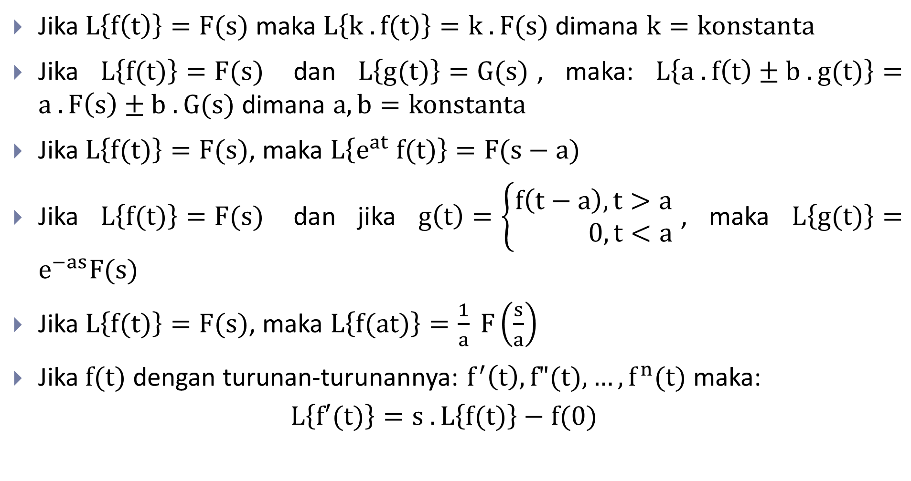
Sifat dan Teorema pada Transformasi Laplace
Jika $L\left\{f\left(t\right)\right\}=F(s)$ maka $L\left\{k . f(t)\right\}=k . F(s)$ dimana $k=konstanta$
Jika $L\left\{f(t)\right\}=F(s)$ dan $L\left\{g(t)\right\}=G(s)$, maka: $L\left\{a . f\left(t\right)±b . g(t)\right\}=a . F\left(s\right)±b . G(s)$ dimana $a,b=konstanta$
Jika $L\left\{f(t)\right\}=F(s)$, maka $L\left\{e^{at} f(t)\right\}=F(s−a)$
Jika $L\left\{f(t)\right\}=F(s)$ dan jika $g\left(t\right)=\left\{\begin{aligned}f\left(t−a\right), t>a \\ 0, t<a\end{aligned}\right.$, maka $L\left\{g(t)\right\}=e^{−as}F(s)$
Jika $L\left\{f(t)\right\}=F(s)$, maka $L\left\{f(at)\right\}=\frac{1}{a} F\left(\frac{s}{a}\right)$
Jika $f(t)$ dengan turunan-turunannya: $f^{′}\left(t\right), f"(t), …, f^{n}(t)$ maka:
$$L\left\{f′(t)\right\}=s . L\left\{f(t)\right\}−f(0)$$

Slide 14
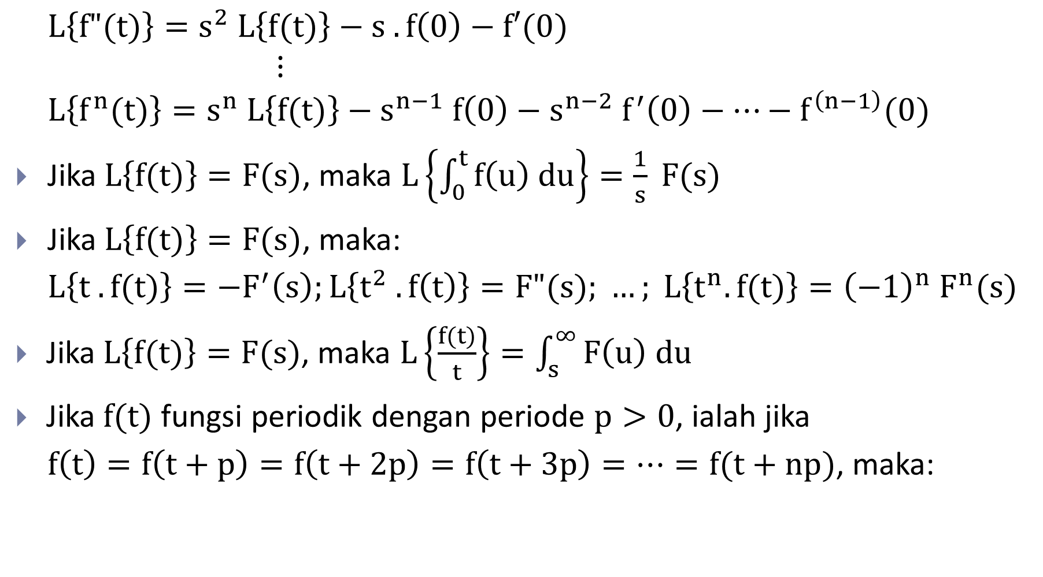
Sifat dan Teorema pada Transformasi Laplace
$$L\left\{f"(t)\right\}=s^{2} L\left\{f(t)\right\}−s . f\left(0\right)−f′(0)$$
$$⋮$$
$$L\left\{f^{n}(t)\right\}=s^{n} L\left\{f(t)\right\}−s^{n−1} f\left(0\right)−s^{n−2} f^{′}\left(0\right)−…−f^{\left(n−1\right)}(0)$$
Jika $L\left\{f(t)\right\}=F(s)$, maka $L\left\{\int_{0}^{t}{f\left(u\right) du}\right\}=\frac{1}{s} F(s)$
Jika $L\left\{f(t)\right\}=F(s)$, maka:
$$L\left\{t . f(t)\right\}=−F^{′}\left(s\right);L\left\{t^{2} . f\left(t\right)\right\}=F"(s); …; L\left\{t^{n}. f(t)\right\}={\left(−1\right)}^{n} F^{n}(s)$$
Jika $L\left\{f(t)\right\}=F(s)$, maka $L\left\{\frac{f(t)}{t}\right\}=\int_{s}^{∞}{F\left(u\right) du}$
Jika $f(t)$ fungsi periodik dengan periode $p>0$, ialah jika
$f\left(t\right)=f\left(t+p\right)=f\left(t+2p\right)=f\left(t+3p\right)=…=f(t+np)$, maka:

Slide 15
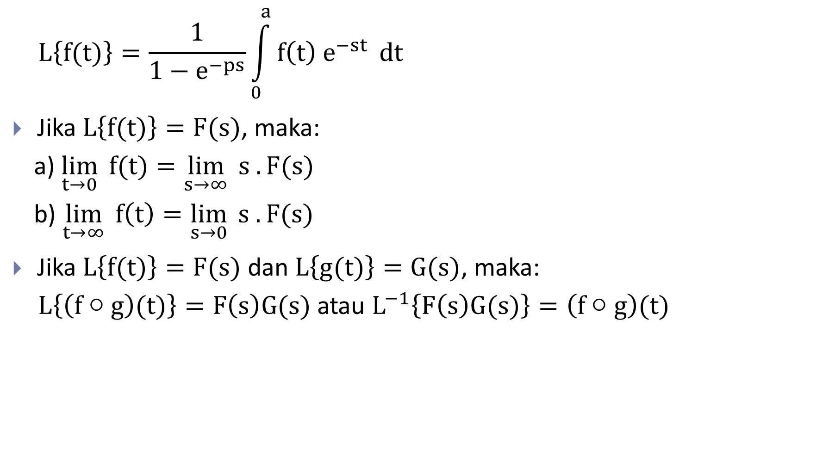
Sifat dan Teorema pada Transformasi Laplace
$$L\left\{f(t)\right\}=\frac{1}{1−e^{−ps}}\int_{0}^{a}{f\left(t\right){ e}^{−st}} dt$$
Jika $L\left\{f(t)\right\}=F(s)$, maka:
a) $\lim_{t→0}{ f(t)}=\lim_{s→∞}{s . F(s)}$
b) $\lim_{t→∞}{f\left(t\right)=\lim_{s→0}{s . F(s)}}$
Jika $L\left\{f(t)\right\}=F(s)$ dan $L\left\{g(t)\right\}=G(s)$, maka:
$L\left\{\left(f○g\right)(t)\right\}=F\left(s\right)G(s)$ atau $L^{−1}\left\{F\left(s\right)G(s)\right\}=\left(f○g\right)(t)$

Slide 16
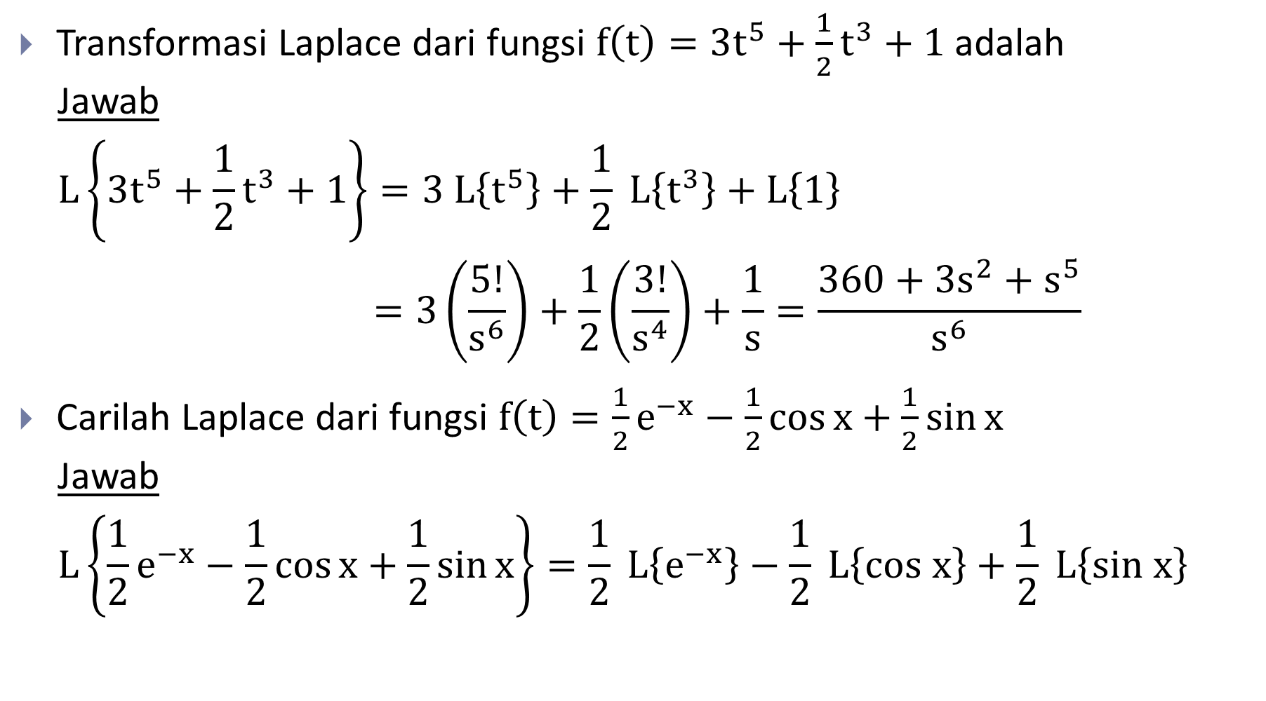
Contoh
Transformasi Laplace dari fungsi $f\left(t\right)=3t^{5}+\frac{1}{2}t^{3}+1$ adalah
Jawab
$$L\left\{3t^{5}+\frac{1}{2}t^{3}+1\right\}=3 L\left\{t^{5}\right\}+\frac{1}{2} L\left\{t^{3}\right\}+L\left\{1\right\}$$
$$=3\left(\frac{5!}{s^{6}}\right)+\frac{1}{2}\left(\frac{3!}{s^{4}}\right)+\frac{1}{s}=\frac{360+3s^{2}+s^{5}}{s^{6}}$$
Carilah Laplace dari fungsi $f\left(t\right)=\frac{1}{2}e^{−x}−\frac{1}{2}\cos{x}+\frac{1}{2}\sin{x}$
Jawab
$$L\left\{\frac{1}{2}e^{−x}−\frac{1}{2}\cos{x}+\frac{1}{2}\sin{x}\right\}=\frac{1}{2} L\left\{e^{−x}\right\}−\frac{1}{2} L\left\{cos x\right\}+\frac{1}{2} L\left\{sin x\right\}$$

Slide 17

Contoh
$$=\frac{1}{2}\left(\frac{1}{s+1}\right)−\frac{1}{2}\left(\frac{s}{s^{2}+1^{2}}\right)+\frac{1}{2}\left(\frac{1}{s^{2}+1^{2}}\right)$$
$$=\frac{1}{2s+2}−\frac{s}{{2s}^{2}+2}+\frac{1}{2s^{2}+2}$$
$$=\frac{1}{2}\left(\frac{s^{2}+1−s^{2}−s+s+1}{\left(s+1\right)\left(s^{2}+1\right)}\right)=\frac{1}{2}\left(\frac{2}{\left(s+1\right)\left(s^{2}+1\right)}\right)$$
$$=\frac{1}{\left(s+1\right)\left(s^{2}+1\right)}$$

Slide 18
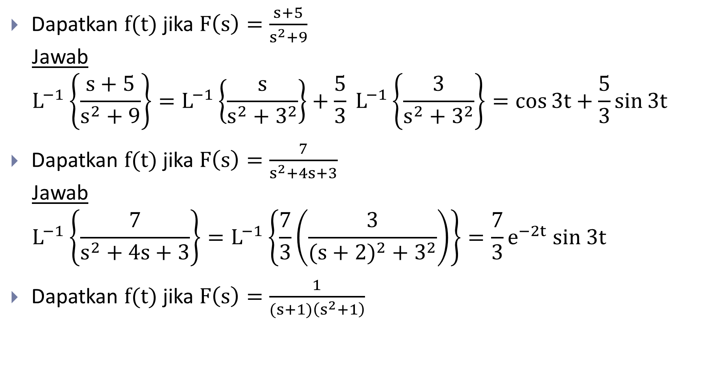
Invers Transformasi Laplace
Dapatkan $f(t)$ jika $F\left(s\right)=\frac{s+5}{s^{2}+9}$
Jawab
$$L^{−1}\left\{\frac{s+5}{s^{2}+9}\right\}=L^{−1}\left\{\frac{s}{s^{2}+3^{2}}\right\}+\frac{5}{3} L^{−1}\left\{\frac{3}{s^{2}+3^{2}}\right\}=\cos{3t}+\frac{5}{3}\sin{3t}$$
Dapatkan $f(t)$ jika $F\left(s\right)=\frac{7}{s^{2}+4s+3}$
Jawab
$$L^{−1}\left\{\frac{7}{s^{2}+4s+3}\right\}=L^{−1}\left\{\frac{7}{3}\left(\frac{3}{({s+2)}^{2}+3^{2}}\right)\right\}=\frac{7}{3}e^{−2t} sin 3t$$
Dapatkan $f(t)$ jika $F\left(s\right)=\frac{1}{(s+1)\left(s^{2}+1\right)}$

Slide 19
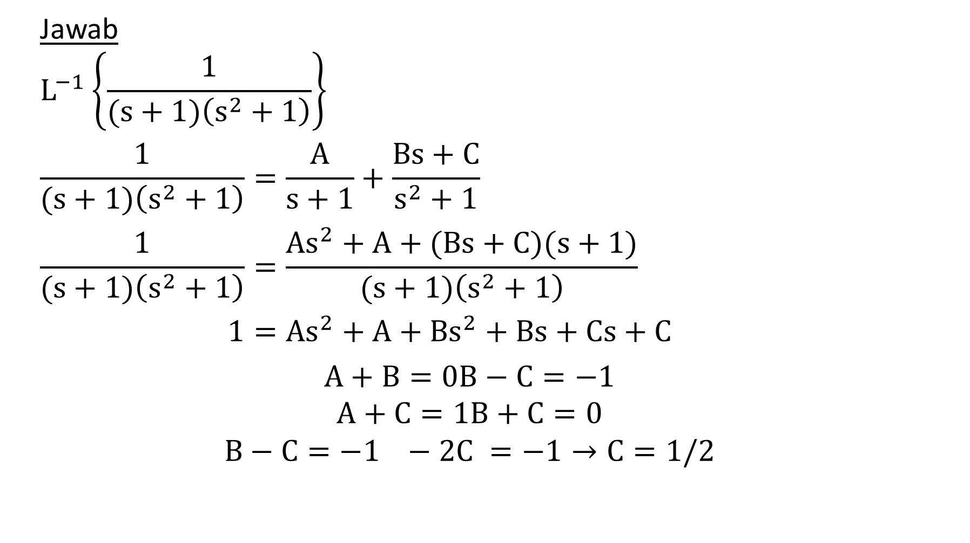
Invers Transformasi Laplace
Jawab
$$L^{−1}\left\{\frac{1}{(s+1)\left(s^{2}+1\right)}\right\}$$
$$\frac{1}{(s+1)\left(s^{2}+1\right)}=\frac{A}{s+1}+\frac{Bs+C}{s^{2}+1}$$
$$\frac{1}{(s+1)\left(s^{2}+1\right)}=\frac{{As}^{2}+A+(Bs+C)(s+1)}{(s+1)\left(s^{2}+1\right)}$$
$$1={As}^{2}+A+{Bs}^{2}+Bs+Cs+C$$
$$A+B=0B−C=−1$$
$$A+C=1B+C=0$$
$$B−C=−1 −2C =−1→C=1/2$$

Slide 20
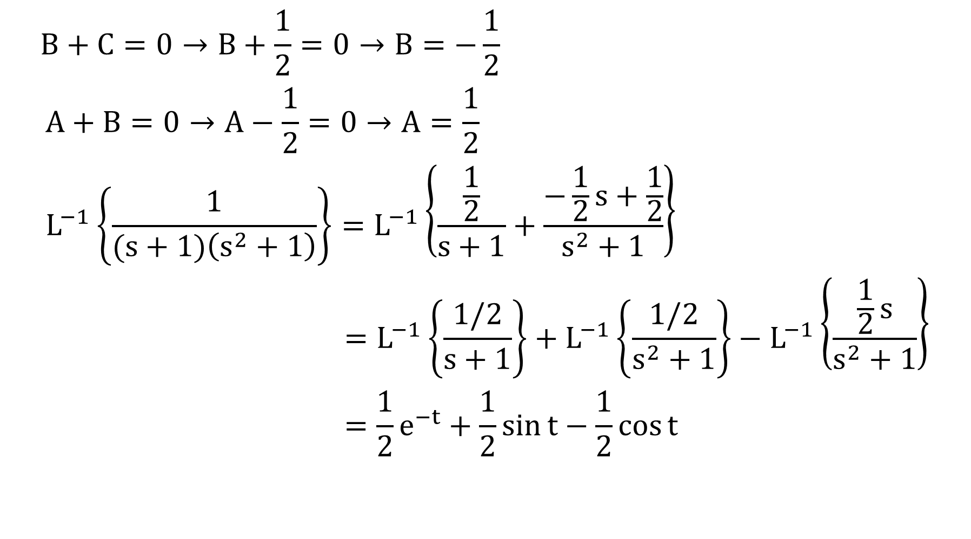
Invers Transformasi Laplace
$$B+C=0→B+\frac{1}{2}=0→B=−\frac{1}{2}$$
$$A+B=0→A−\frac{1}{2}=0→A=\frac{1}{2}$$
$$L^{−1}\left\{\frac{1}{(s+1)\left(s^{2}+1\right)}\right\}=L^{−1}\left\{\frac{\frac{1}{2}}{s+1}+\frac{−\frac{1}{2}s+\frac{1}{2}}{s^{2}+1}\right\}$$
$$=L^{−1}\left\{\frac{1/2}{s+1}\right\}+L^{−1}\left\{\frac{1/2}{s^{2}+1}\right\}−L^{−1}\left\{\frac{\frac{1}{2}s}{s^{2}+1}\right\}$$
$$={\frac{1}{2}e}^{−t}+\frac{1}{2}\sin{t}−\frac{1}{2}\cos{t}$$

Slide 21
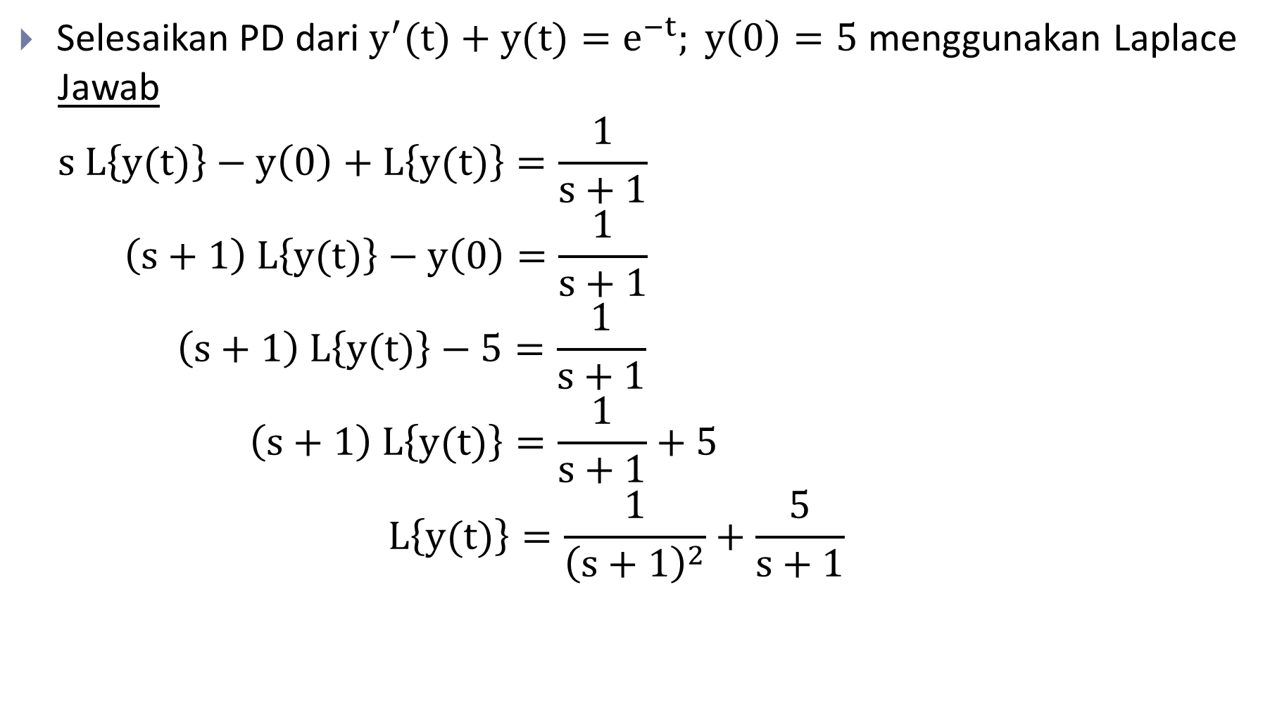
Penyelesaian PD Menggunakan Transformasi Laplace
Selesaikan PD dari $y^{′}(t)+y(t)=e^{−t}; y\left(0\right)=5$ menggunakan Laplace
Jawab
$$s L\left\{y(t)\right\}−y\left(0\right)+L\left\{y(t)\right\}=\frac{1}{s+1}$$
$$\left(s+1\right) L\left\{y(t)\right\}−y\left(0\right)=\frac{1}{s+1}$$
$$\left(s+1\right) L\left\{y(t)\right\}−5=\frac{1}{s+1}$$
$$\left(s+1\right) L\left\{y(t)\right\}=\frac{1}{s+1}+5$$
$$L\left\{y(t)\right\}=\frac{1}{{\left(s+1\right)}^{2}}+\frac{5}{s+1}$$

Slide 22

PUPD Menggunakan Transformasi Laplace
$$y=L^{−1}\left\{\frac{1}{{\left(s+1\right)}^{2}}+\frac{5}{s+1}\right\}$$
$$y=te^{−t}+5e^{−t}$$

Slide 23

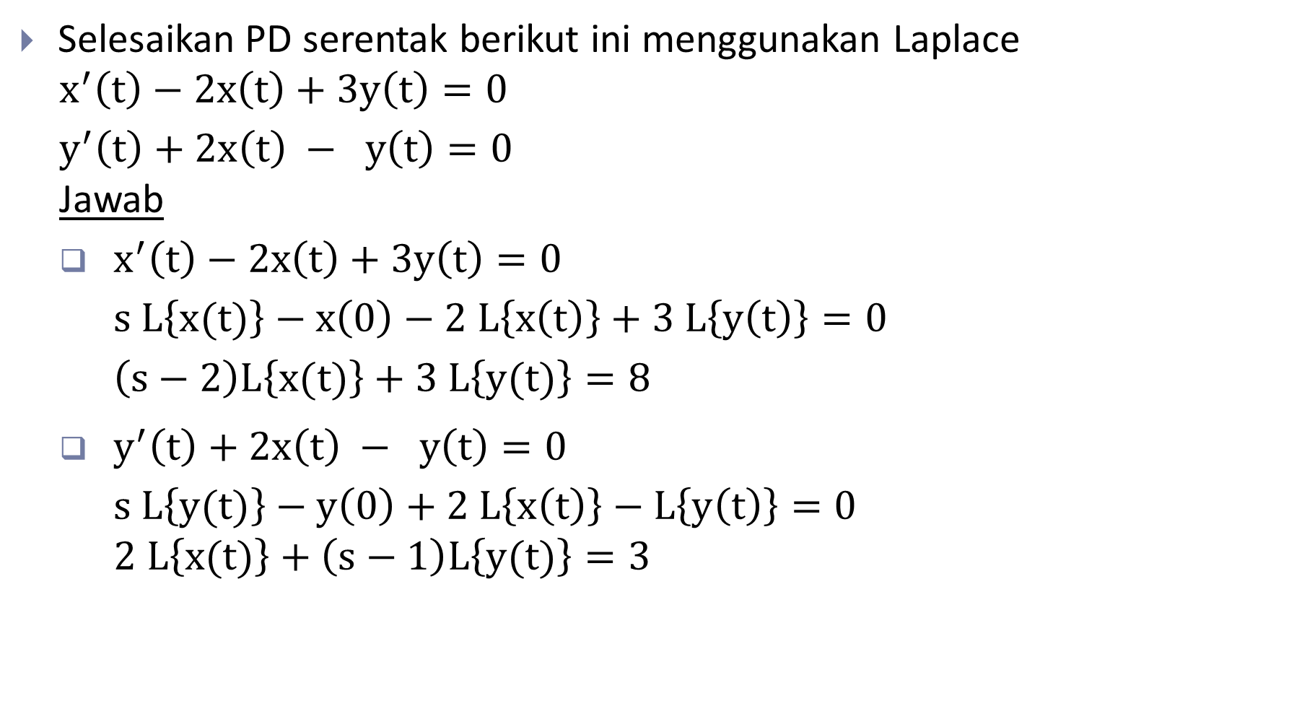
Penyelesaian PD Serentak Menggunakan Transformasi Laplace
Selesaikan PD serentak berikut ini menggunakan Laplace
$$x^{′}\left(t\right)−2x\left(t\right)+3y\left(t\right)=0$$
$$y^{′}\left(t\right)+2x\left(t\right) − y\left(t\right)=0$$
Jawab
$x^{′}\left(t\right)−2x\left(t\right)+3y\left(t\right)=0$
$$s L\left\{x(t)\right\}−x\left(0\right)−2 L\left\{x\left(t\right)\right\}+3 L\left\{y\left(t\right)\right\}=0$$
$$\left(s−2\right)L\left\{x(t)\right\}+3 L\left\{y(t)\right\}=8$$
$y^{′}\left(t\right)+2x\left(t\right) − y\left(t\right)=0$
$$s L\left\{y(t)\right\}−y\left(0\right)+2 L\left\{x\left(t\right)\right\}−L\left\{y\left(t\right)\right\}=0$$
$$2 L\left\{x(t)\right\}+\left(s−1\right)L\left\{y(t)\right\}=3$$
$$x\left(0\right)=8 dan y\left(0\right)=3$$

Slide 24
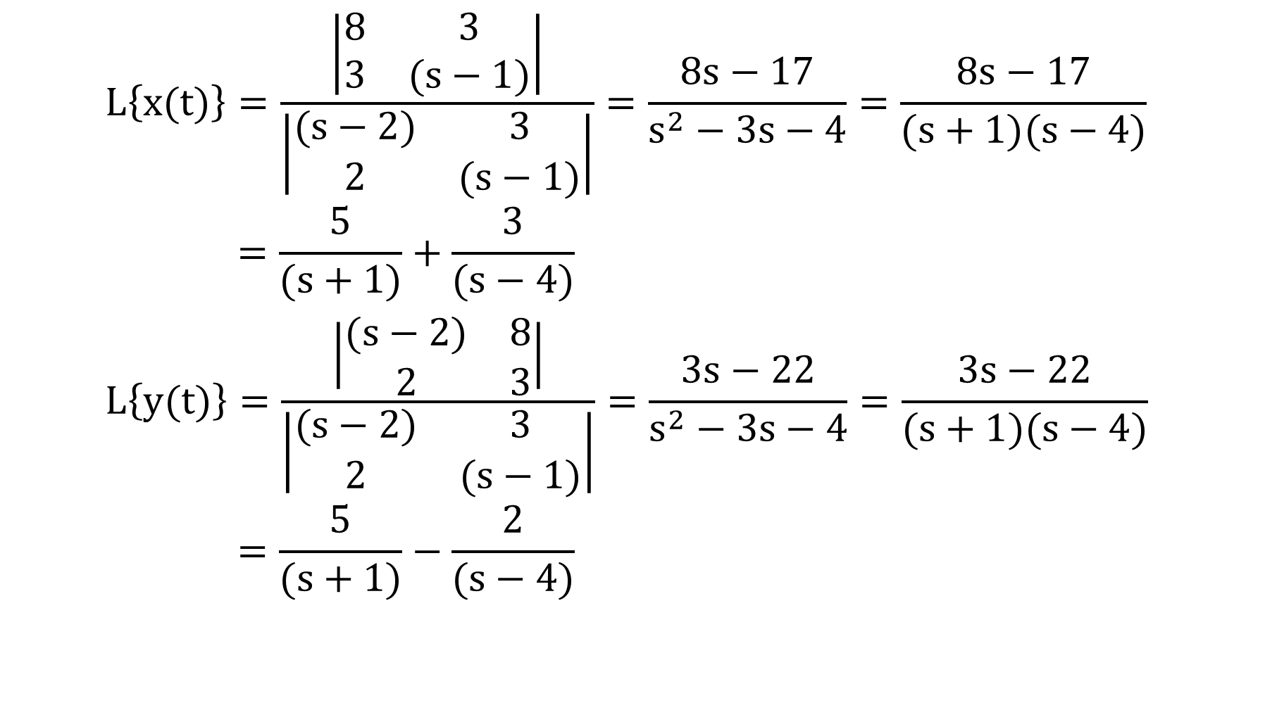
Penyelesaian PD Serentak Menggunakan Transformasi Laplace
$$L\left\{x(t)\right\}=\frac{\left|\begin{matrix}8 & 3 \\ 3 & (s−1)\end{matrix}\right|}{\left|\begin{matrix}(s−2) & 3 \\ 2 & (s−1)\end{matrix}\right|}=\frac{8s−17}{s^{2}−3s−4}=\frac{8s−17}{(s+1)(s−4)}$$
$$=\frac{5}{(s+1)}+\frac{3}{(s−4)}$$
$$L\left\{y(t)\right\}=\frac{\left|\begin{matrix}(s−2) & 8 \\ 2 & 3\end{matrix}\right|}{\left|\begin{matrix}(s−2) & 3 \\ 2 & (s−1)\end{matrix}\right|}=\frac{3s−22}{s^{2}−3s−4}=\frac{3s−22}{(s+1)(s−4)}$$
$$=\frac{5}{(s+1)}−\frac{2}{(s−4)}$$

Slide 25

Penyelesaian PD Serentak Menggunakan Transformasi Laplace
$$x\left(t\right)=L^{−1}\left\{\frac{5}{\left(s+1\right)}+\frac{3}{\left(s−4\right)}\right\}=5 L^{−1}\left\{\frac{1}{s+1}\right\}+3 L^{−1}\left\{\frac{1}{s−4}\right\}$$
$$=5e^{−t}+3e^{4t}$$
$$y\left(t\right)=L^{−1}\left\{\frac{5}{\left(s+1\right)}−\frac{2}{\left(s−4\right)}\right\}=5 L^{−1}\left\{\frac{1}{s+1}\right\}−2 L^{−1}\left\{\frac{1}{s−4}\right\}$$
$$=5e^{−t}−2e^{4t}$$

Slide 26


