Slide 1



RESEARCH METHODS
IN INTERNATIONAL RELATIONS
Pertemuan Ke-4 06-10-2020
DR. UMAR S. BAKRY, MA
www.umarbakry.com/08111755379 (WA)

Slide 2

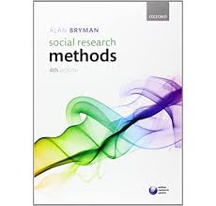
BUKU REFERENSI JENIS, TUJUAN DAN PERTANYAAN PENELITIAN

Slide 3
PERBEDAAN ISTILAH
Metode
Metodologi
Metode Penelitian
Metodologi Penelitian

Slide 4
JENIS DAN METODE PENELITIAN BERDASARKAN TEMPAT PENELITIAN
NO | TYPES OF RESEARCH | RESEARCH METHODS
1 | DOCUMENT-BASED RESEARCH | Analysis of historical records Analysis of documents (literature)
2 | FIELD RESEARCH | Non-participant direct observation Participant observation Mass observation Mail questionnaire Personal interview Focused interview Group interview Telephone survey Public opinion survey Case study and life history
3 | LABORATORY RESEARCH | Small study group of random behavior, play, and role analysis

Slide 5

DOCUMENT-BASED RESEARCH
Di Indonesia jenis penelitian ini banyak dikenal dengan library research (penelitian kepustakaan), yakni suatu kegiatan penelitian yang tempat penelitiannya di perpustakaan.
Yang dicari jenis penelitian semacam ini adalah dokumen-dokumen (berupa buku, jurnal, majalah, surat kabar, dan dokumen tertulis lainnya) yang umumnya tersedia di perpustakaan.
Namun istilah library research kurang banyak dikenal dalam buku-buku metode riset di negara-negara maju. Istilah document-based research ternyata lebih banyak digunakan oleh ahli-ahli penelitian sosial, termasuk ahli penelitian HI seperti Christopher Lamont dalam bukunya Research Methods in International Research (2015).

Slide 6

LABORATORY RESEARCH
Sesuai namanya, jenis penelitian ini tempat penelitiannya dilakukan di laboratorium (laboratory). .
Ketika mendengar kata laboratory banyak orang menganggap bahwa ini adalah hanya tempat penelitiannya para ilmuwan dari ilmu-ilmu alam, padahal ilmu-ilmu sosial pun juga mengenal laboratorium.
Di beberapa kampus ada Laboratorium Ilmu Politik atau Laboratorium Hubungan Internasional.
Tentu penelitian di laboratorium ilmu-ilmu sosial tidak menggunakan alat-alat seperti di lab ilmu-ilmu alam, namun menggunakan teknik-teknik seperti small study group of random behavior, play, and role analysis.

Slide 7
JENIS-JENIS PENELITIAN BERDASARKAN TUJUANNYA
Exploratory Research
Descriptive Research
Explanative Research
Evaluative Research
Predictive/Prescriptive Research
Historical Research
Interpretive Research
Emancipatory Research
Comparative Research

Slide 8
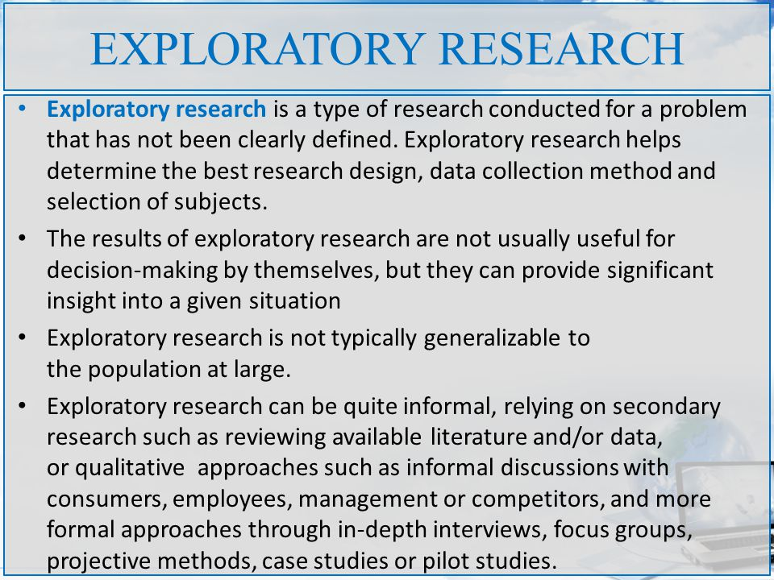

Slide 9
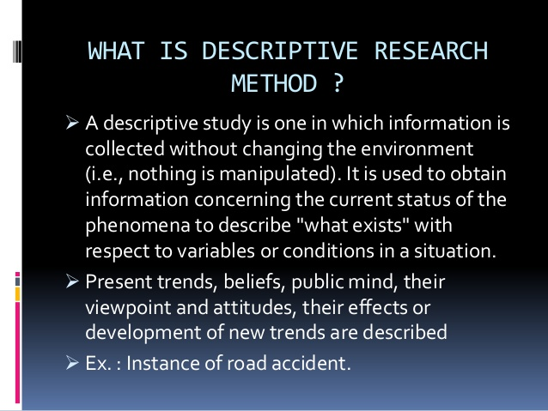

Slide 10
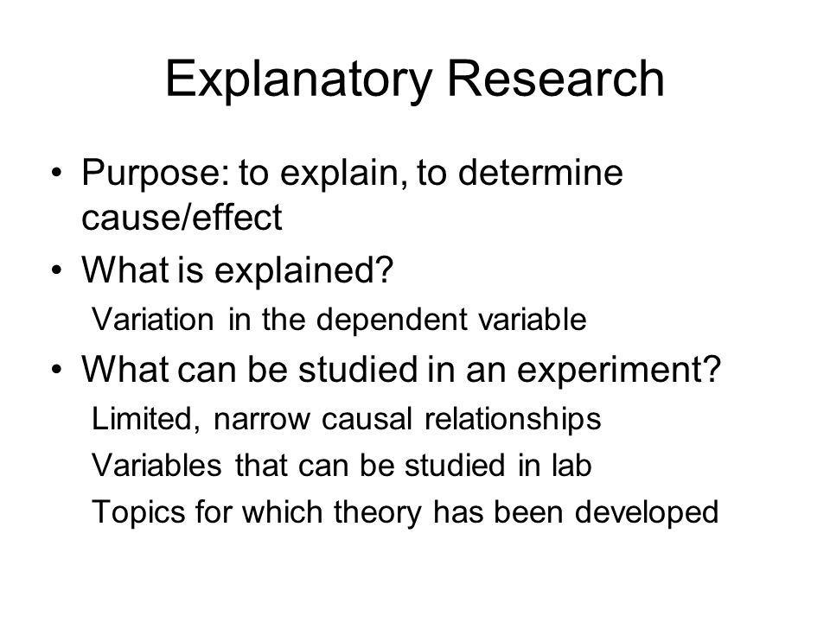

Slide 11
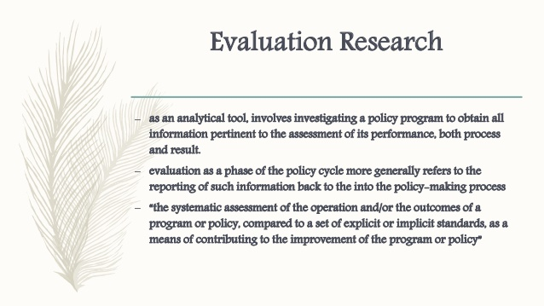

Slide 12
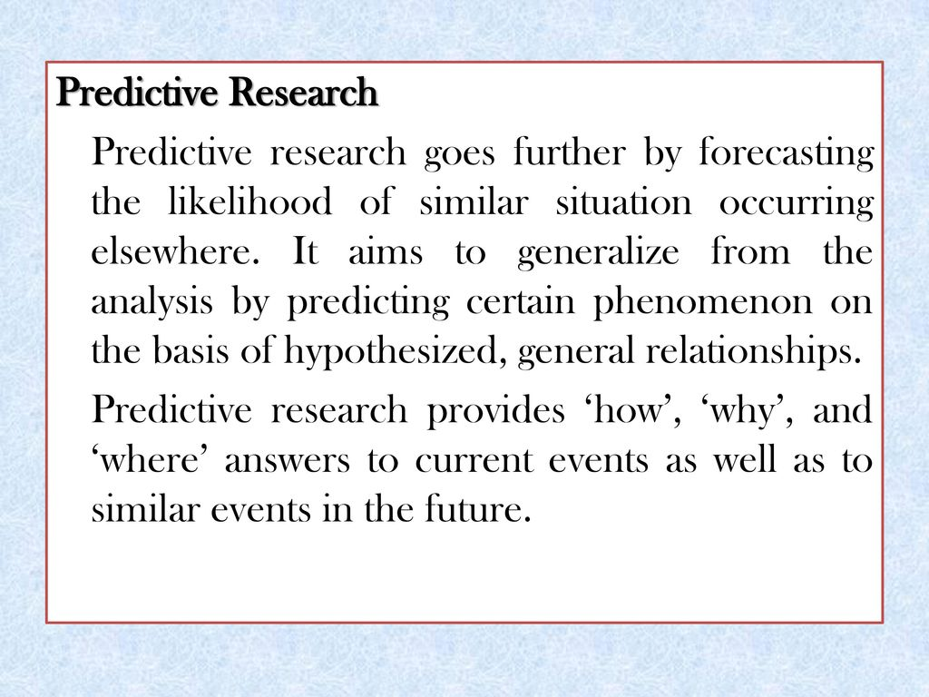

Slide 13
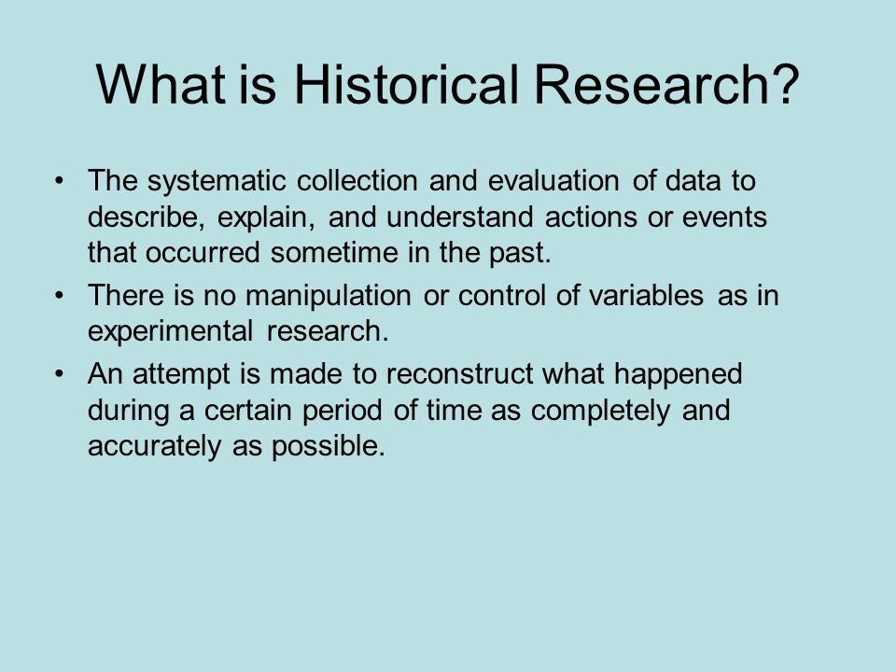

Slide 14
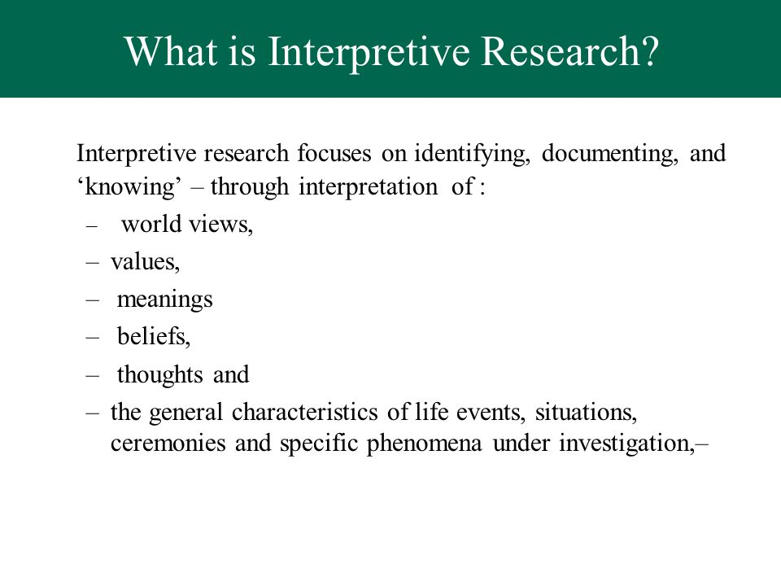

Slide 15
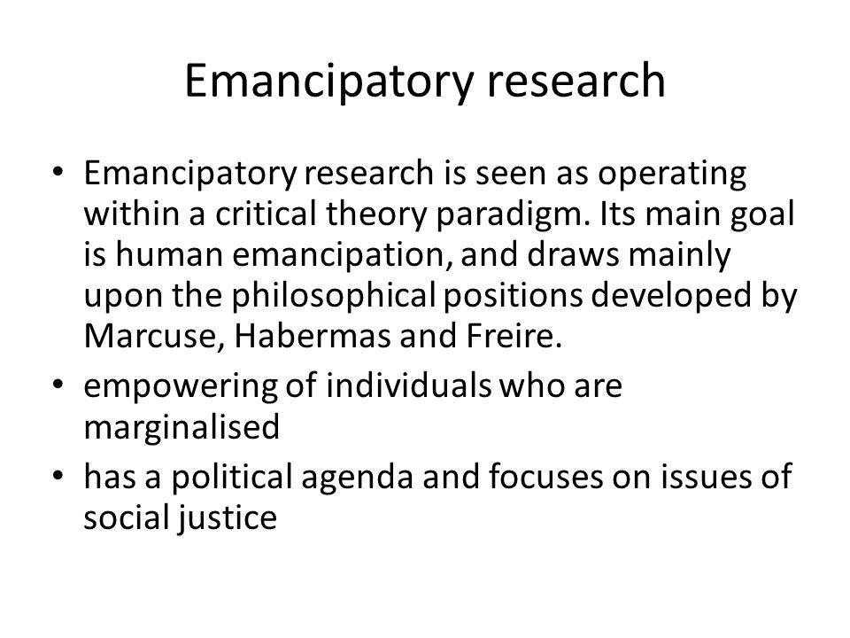

Slide 16
Research Question and Types of Research
Research question have two purpose: (1) to determine what type of research will be used by the researcher; and (2) to identify the specific objectives of the research to be done.
The formulation of research questions is closely related to the purpose or type of research.
Different purposes or types of research will be different the formulation of research questions.
Social researchers usually ask two types of research questions that have relevance to the purpose of research, namely what is going on? (What happens) and why is it going on? (Why it happened).
The first research question formula (what is going on) means that the purpose of the research is to know an event (descriptive research type). While the second research question formula (why is it going on) means that the purpose of the research is to explain why the event occurred (type of explanatory research).

Slide 17
The Relationship Between the Types, Objectives and Research Questions
TYPES/AIMS OF RESEARCH | RESEARCH QUESTION STARTED WITH
Exploratory | What is the case? Apa masalahnya? What are the key factors? Apa saja faktor kuncinya?
Descriptive | How many? What is the incidence of x? Apa pengaruh dari x? Are variable x and variable y related?
Explanative | Why? What are the causes of variable y?
Evaluative | What was the outcome of x? Has the P been successful?
Predictive/ Prescriptive | What will the effect of variable x be on variable y? What happens if….?
Historical | What led to y happening? What were the events that led up to y?
Interpretive | How can we understand a phenomenon?
Emancipatory | How to disrupt convention and empower participants?
Comparative | Do a and b differ in respect of x?

Slide 18

TERIMA KASIH

Slide 19
QUIS MPHI
QUIZIZZ.COM
LINK https://quizizz.com/join?gc=716569

