Slide 1
Industrial Water Treatment Process
Donna Imelda
Chemical Engineering Department Jayabaya University

Slide 2
Tujuan
Secara Fisika
Memisahkan padatan kasar dan terapung
Memisahkan padatan tersuspensi
Memisahkan lemak
Secara Kimia
Pengendapan zat-zat terlarut dengan menggunakan koagulan
Menghilangkan zat-zat racun dan bibit-bibit penyakit
Menghilangkan bau dan rasa

Slide 3
Industrial Water Treatment Process
Pre Treatment
Koagulasi
Flokulasi
Sedimentasi
Filtrasi
Softening

Slide 4
Pre-Treatment
Industrial Water Treatment Process

Slide 5
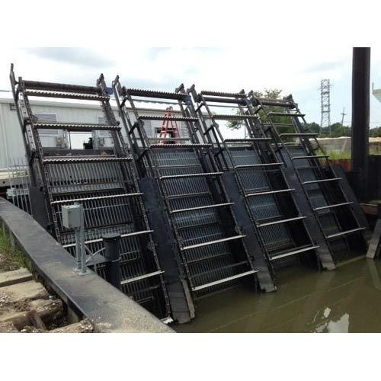
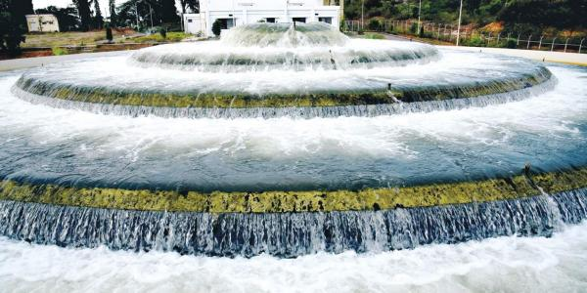
Pre Treatment
Bar Screen
Aeration

Slide 6
Koagulasi & Flokulasi
Industrial Water Treatment Process

Slide 7
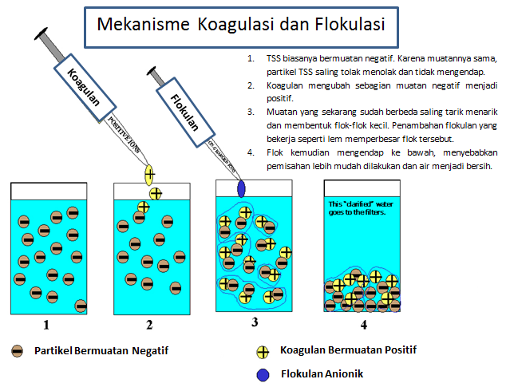

Slide 8
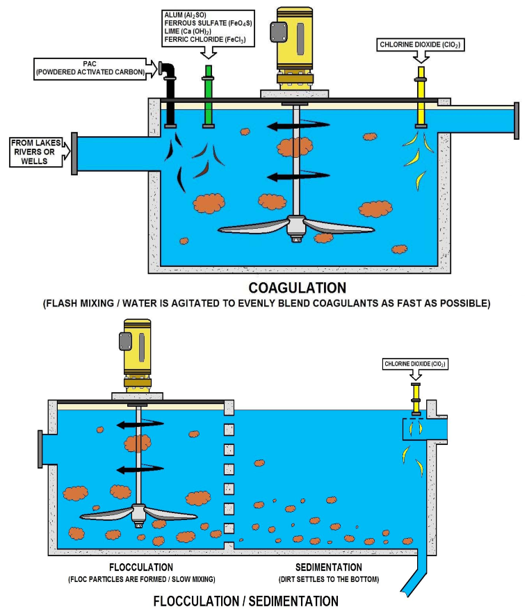
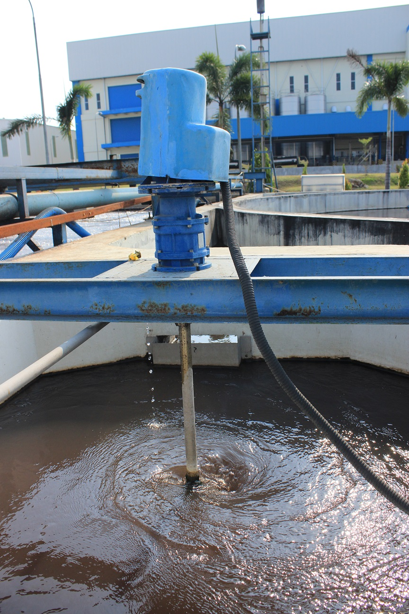

Slide 9
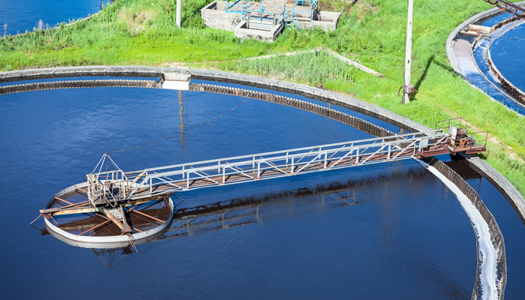

Slide 10
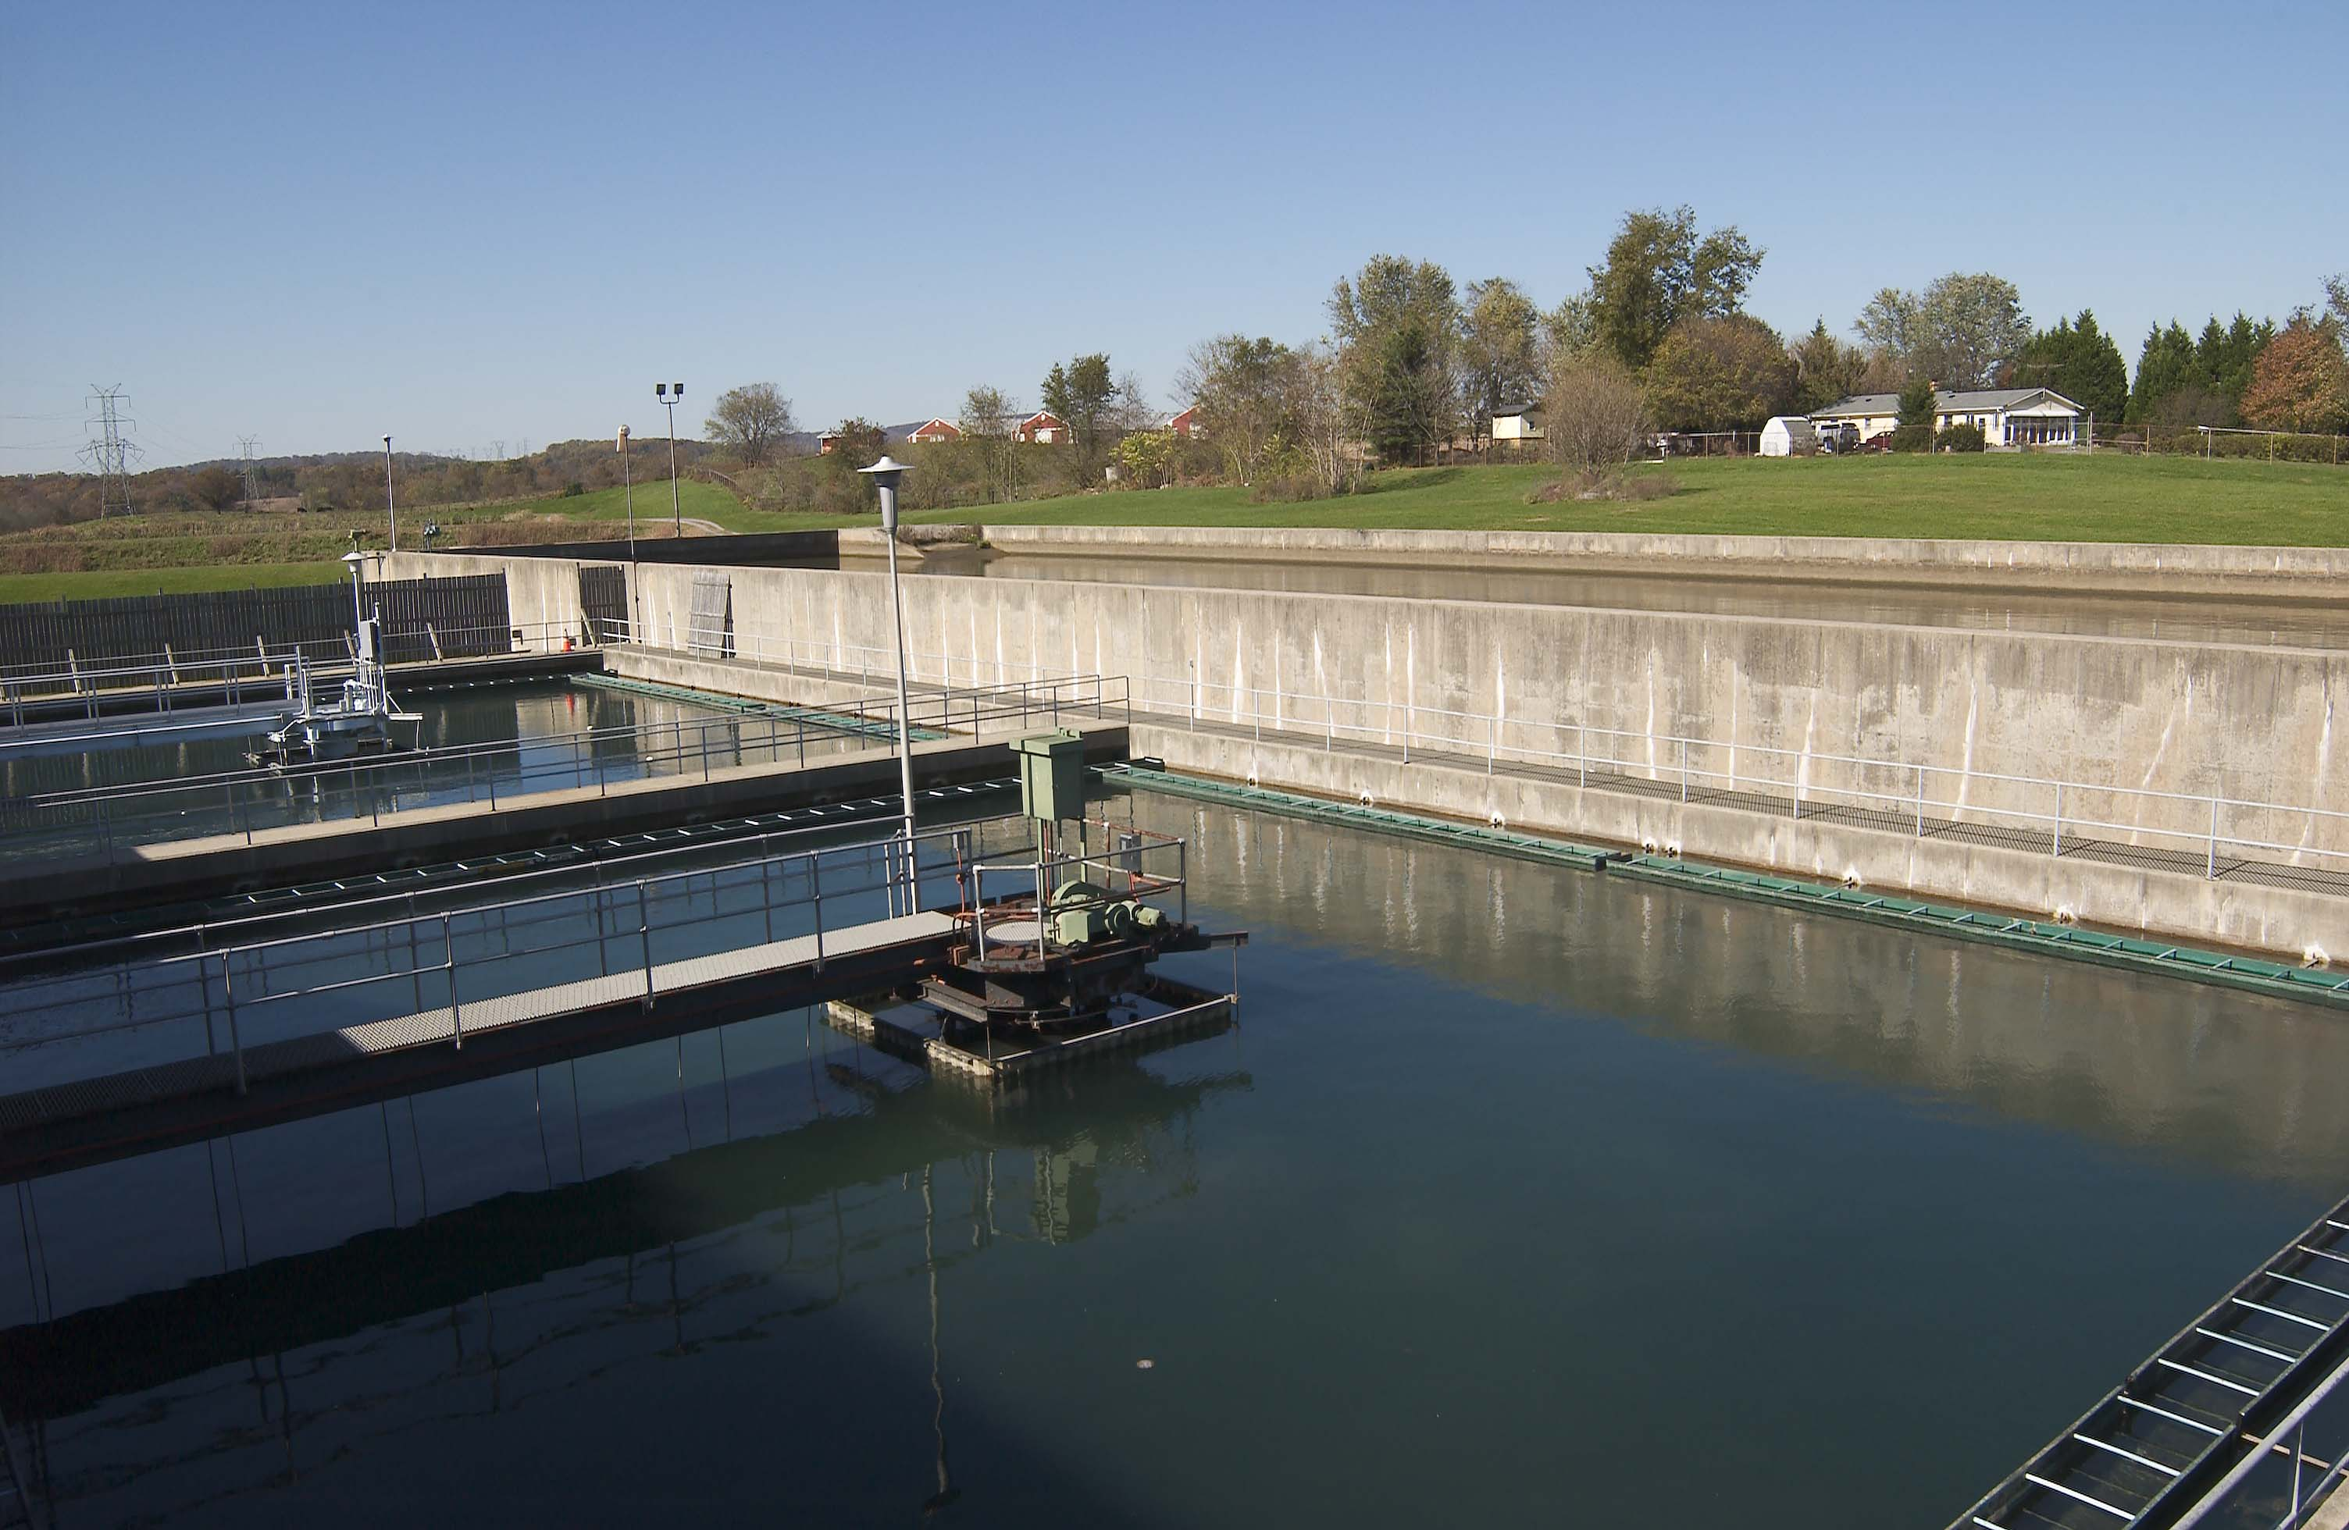

Slide 11
Sedimentasi
Industrial Water Treatment Process

Slide 12
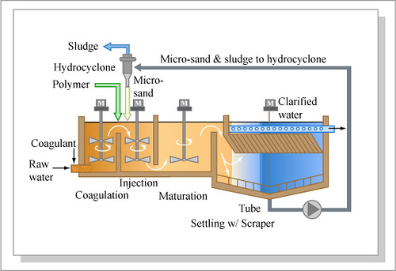

Slide 13
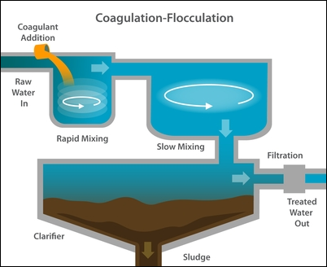

Slide 14
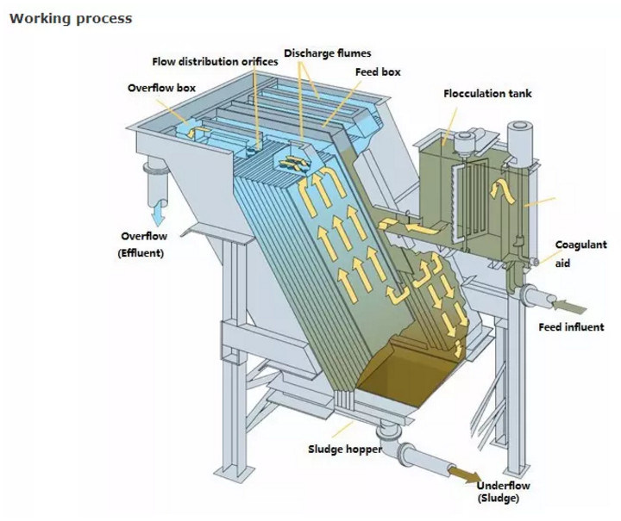
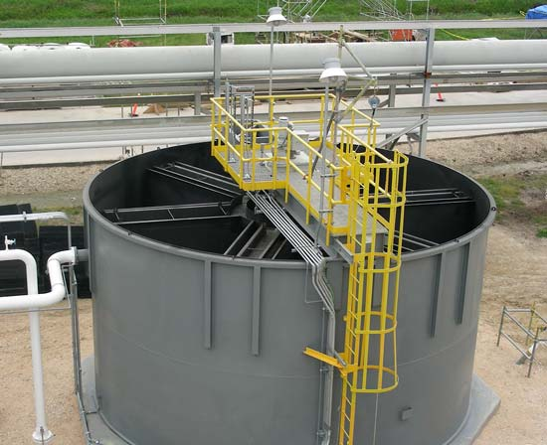
Clarifier Tank

Slide 15
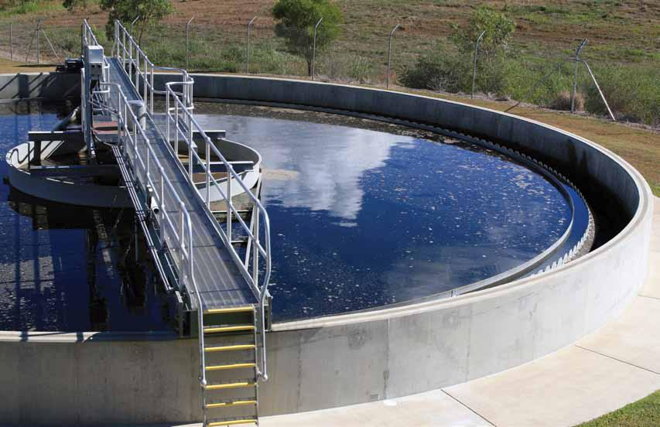

Slide 16
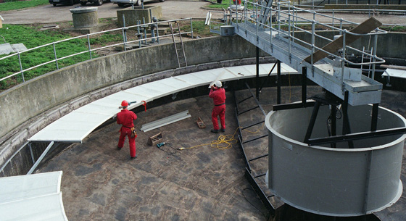

Slide 17
Filtrasi
Industrial Water Treatment Process

Slide 18
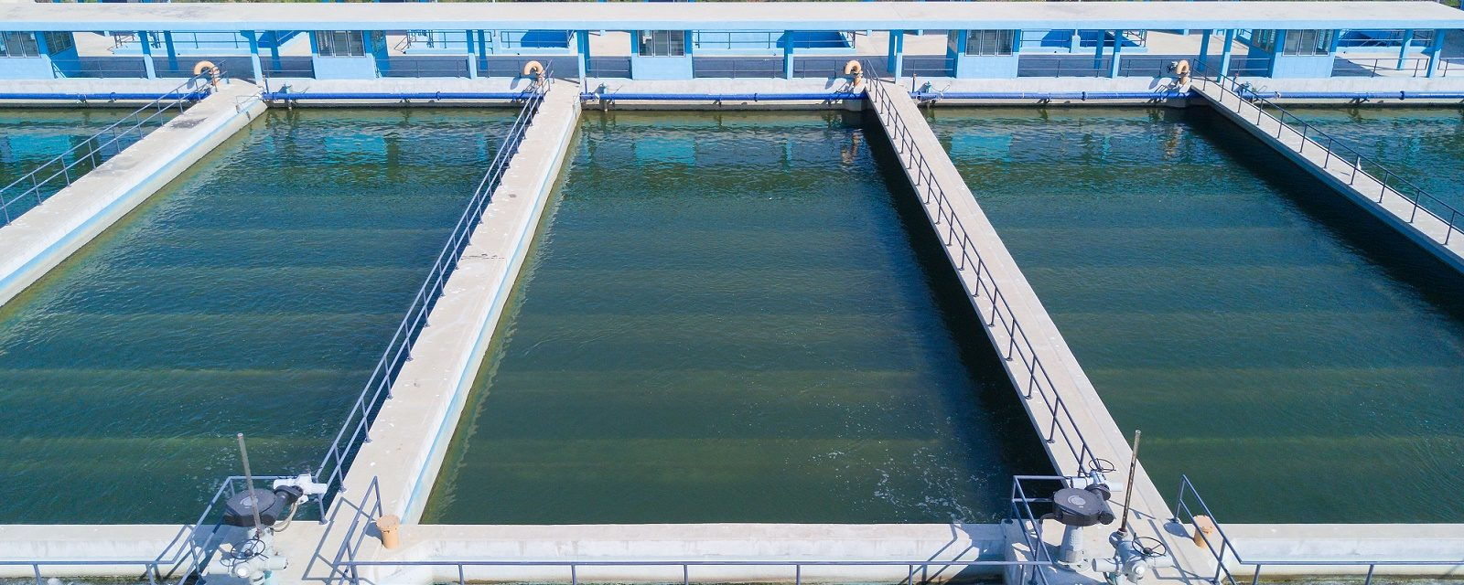

Slide 19
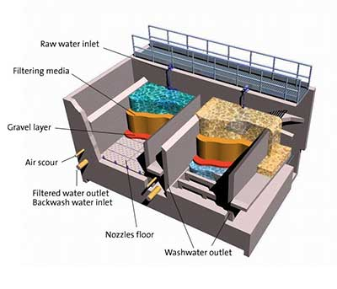
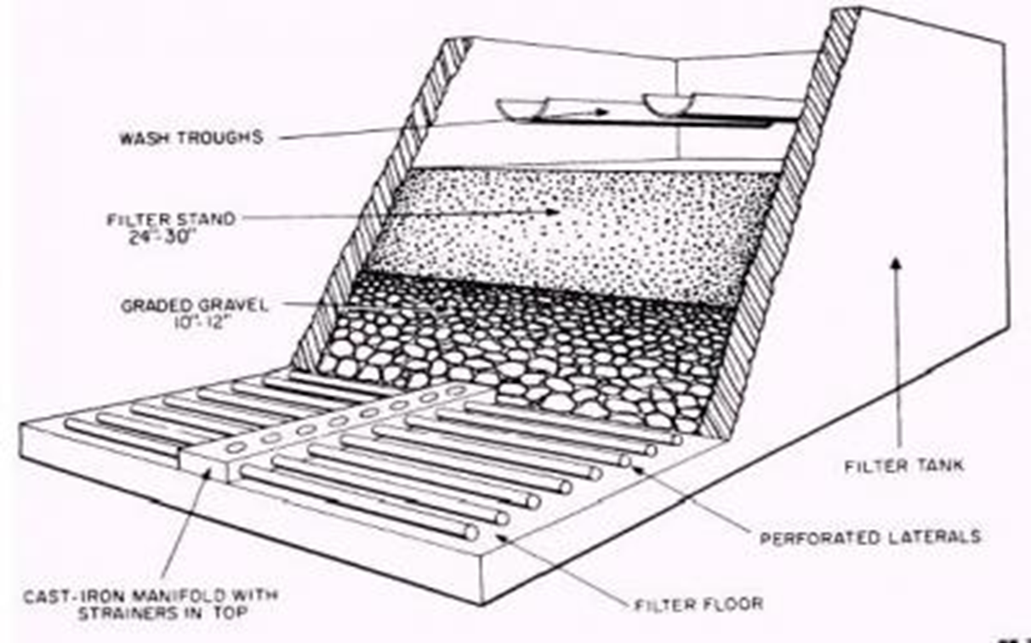

Slide 20
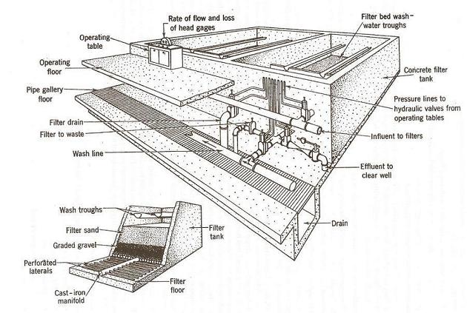

Slide 21
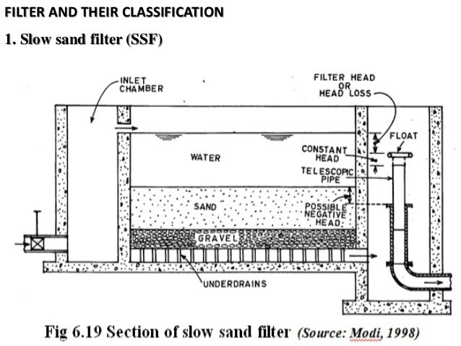

Slide 22
Softening
Industrial Water Treatment Process

Slide 23
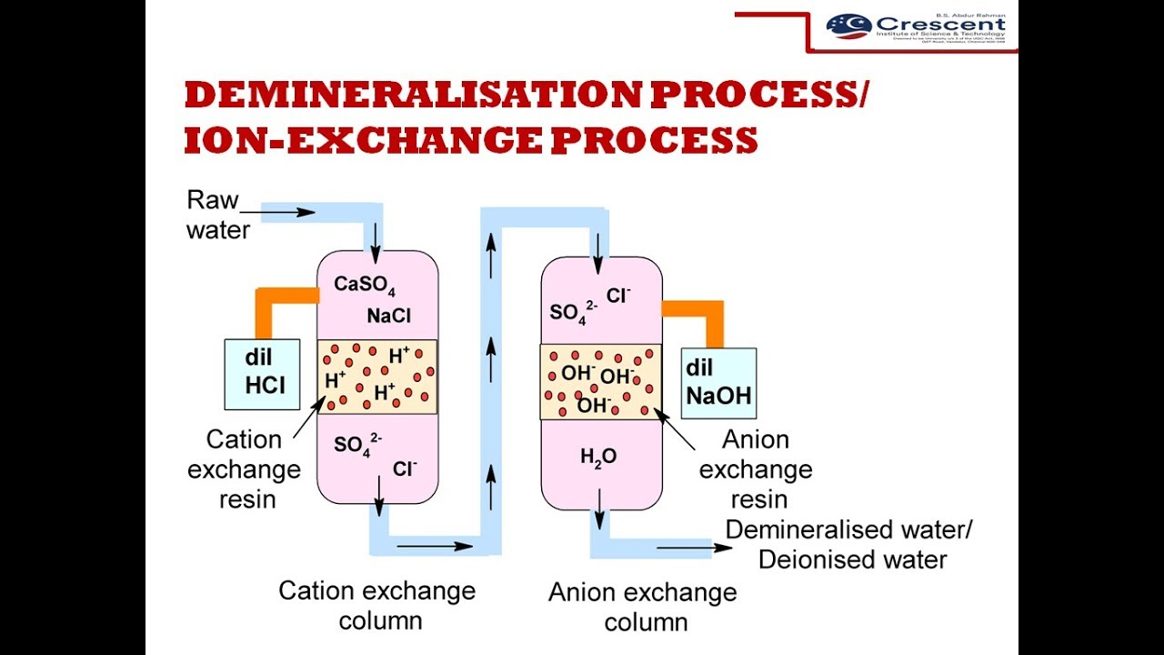
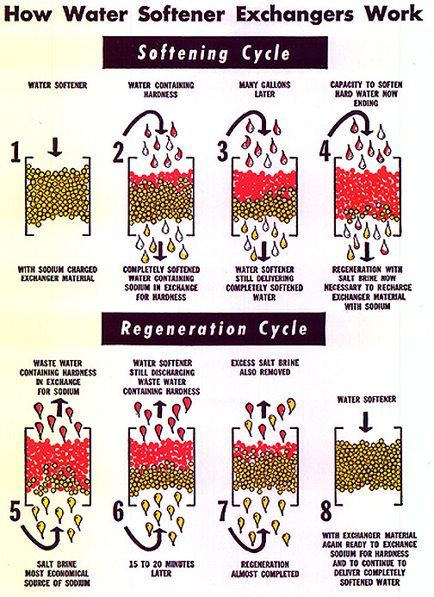

Slide 24
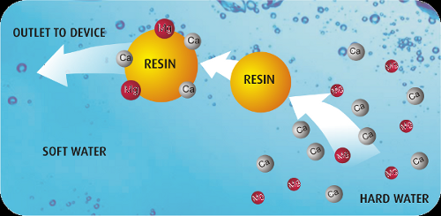

Slide 25
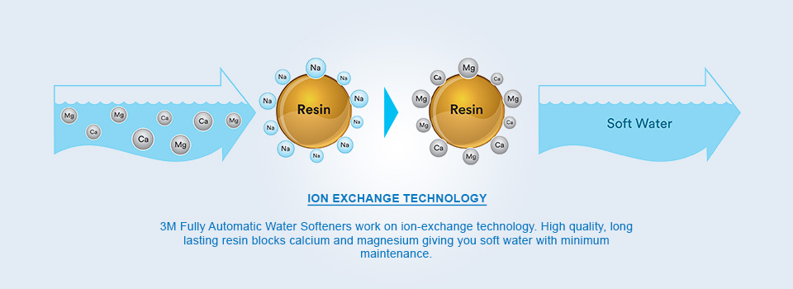

Slide 26
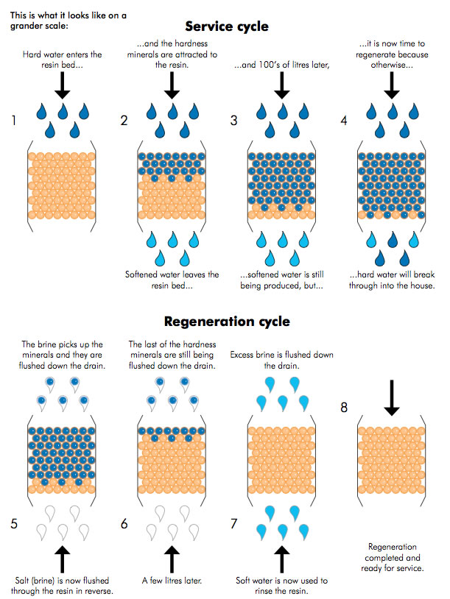
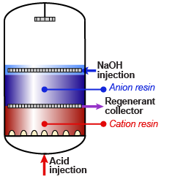

Slide 27
See you on the next class!
Donna Imelda

Slide 28
Video Sources
Water Treatment | Coagulant Aids
https://www.youtube.com/watch?v=TqtcExb6IVc
Flocculation
https://www.youtube.com/watch?v=eST7k0lSICw
https://www.youtube.com/watch?v=R5smisHPqWk
Slow Sand Filter
https://www.youtube.com/watch?v=fBKlXDx6txo
Coagulation n flocculation Basic
https://www.youtube.com/watch?v=qV_1jfmhpnA
Lime Softening
https://www.youtube.com/watch?v=4nYhnRCN3aI
All things water course
https://www.youtube.com/watch?v=sb_heMM5vzs
Back washing
https://www.youtube.com/watch?v=PjLqYmjsIuk
Water Treatment
https://www.youtube.com/watch?v=9z14l51ISwg
https://www.youtube.com/watch?v=0_ZcCqqpS2o&t=136s
https://www.youtube.com/watch?v=3WEbeSp2erM

